Slide 1
From PMI to Bots

Slide 2
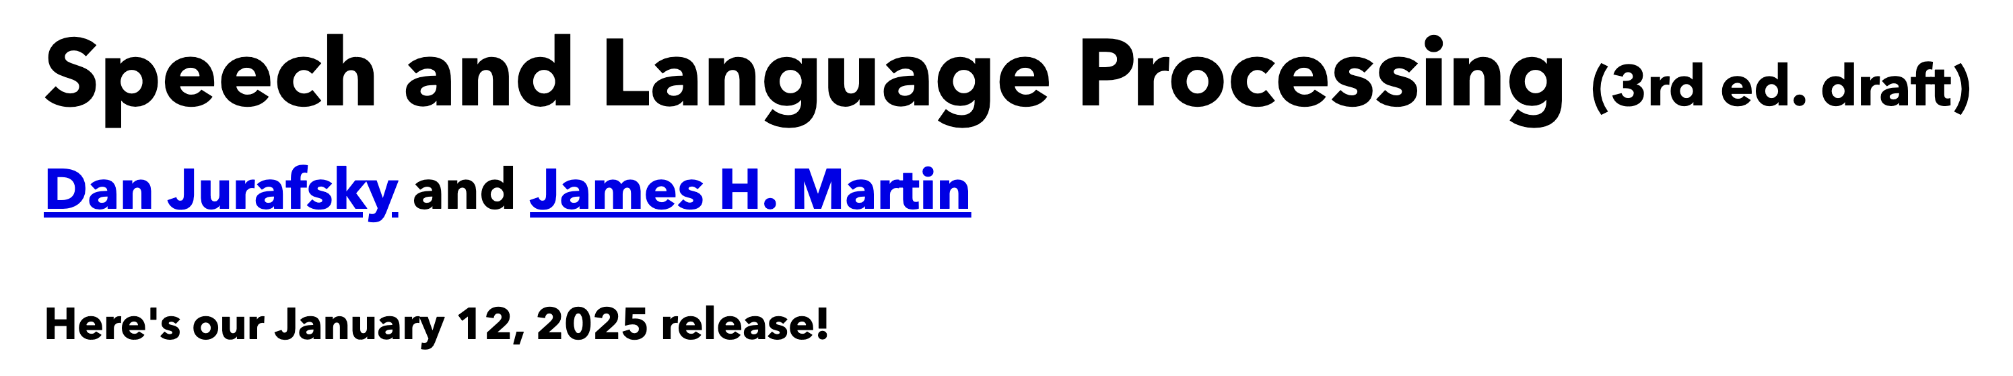
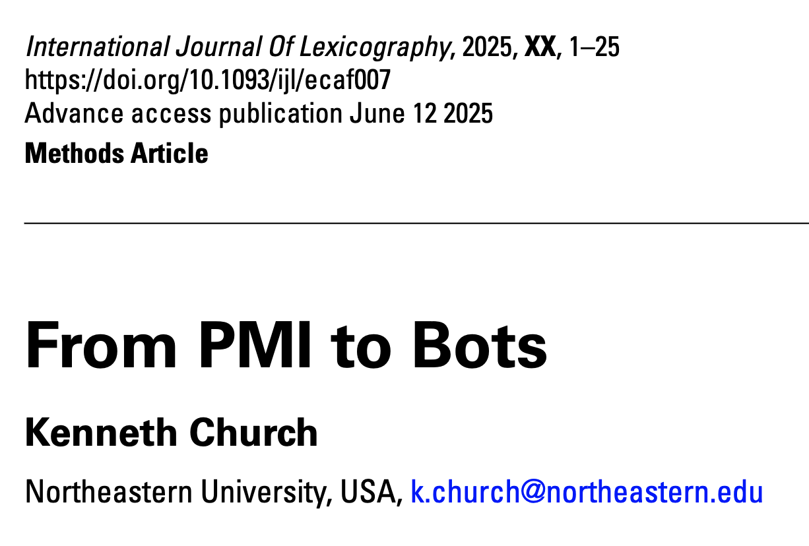
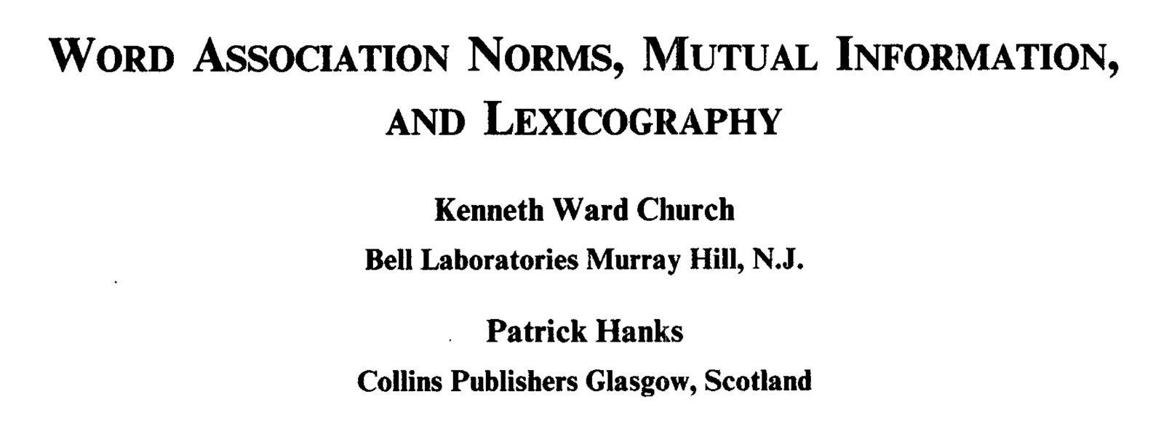
Background Reading for Today
JM: Chapter 6 (especially 6.6)
Word Association Norms, Mutual Information, and Lexicography
https://aclanthology.org/J90-1003/
From PMI to Bots (optional)

Slide 3

Textbook

Slide 4
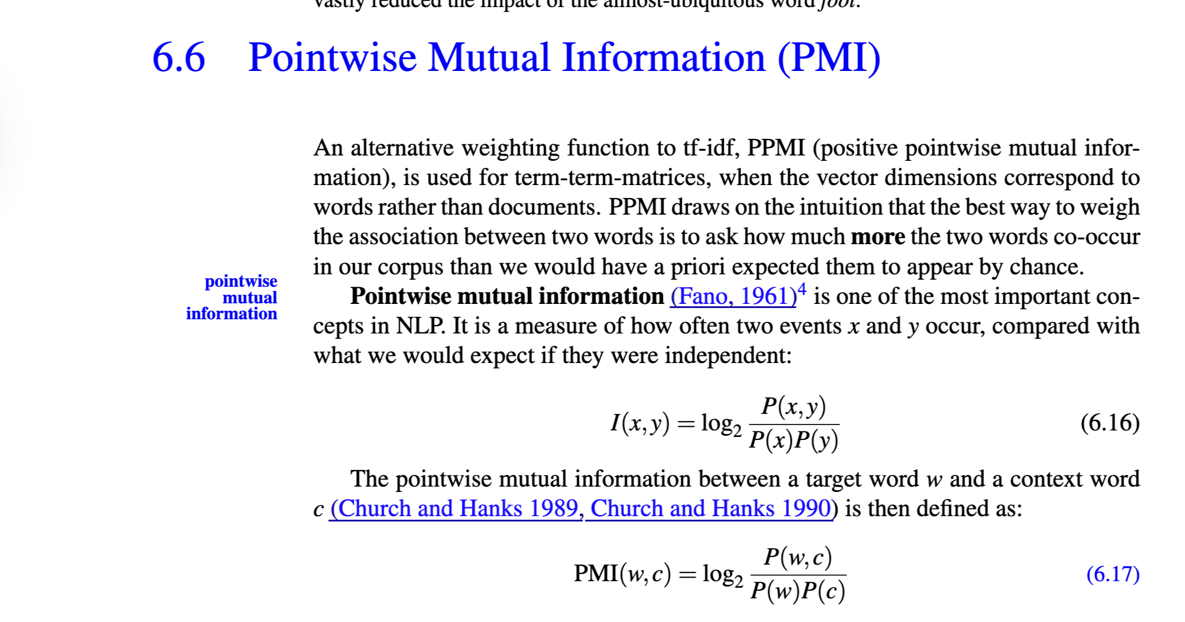
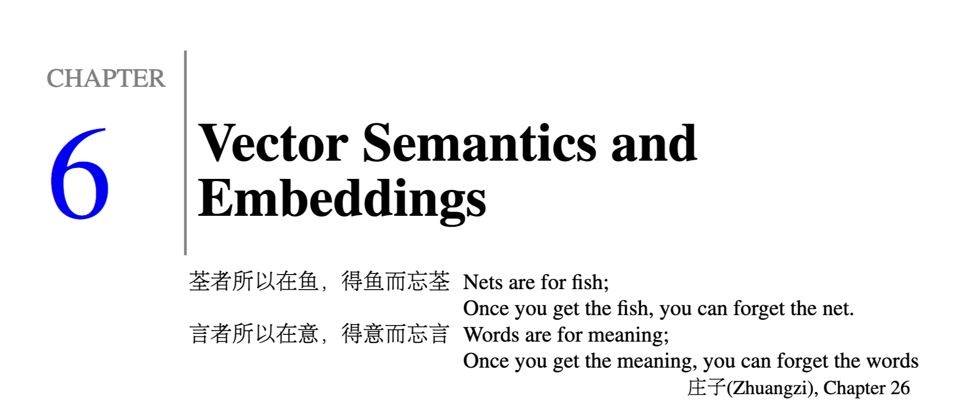

Slide 5

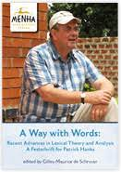
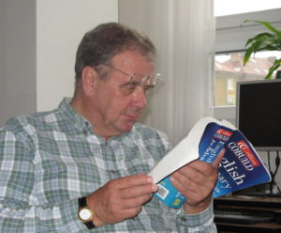


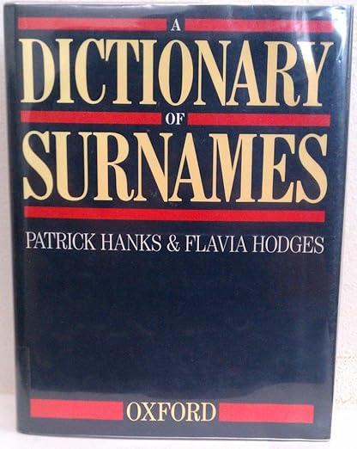
Special Issue of International Journal of Lexicography in Memory of Patrick Hanks

Slide 6

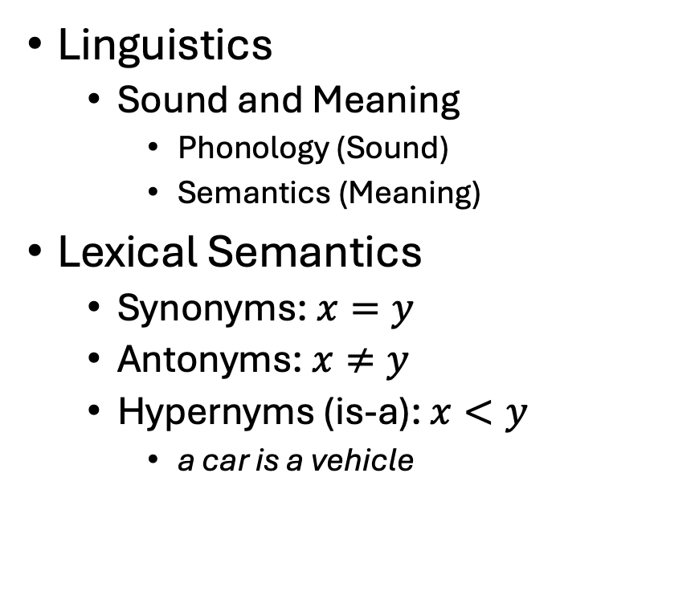
Vectors →Lexical Semantics
Linguistics
Sound and Meaning
Phonology (Sound)
Semantics (Meaning)
Lexical Semantics
Synonyms: $x=y$
Antonyms: $x≠y$
Hypernyms (is-a): $x<y$
a car is a vehicle
Related Topics
Ontologies
Semantic Networks
WordNet
Vectors:
More modern view of meaning
Behind much of the recent excitement in AI
Large Language Models (LLM)
Bots: ChatGPT, DeepSeek

Slide 7
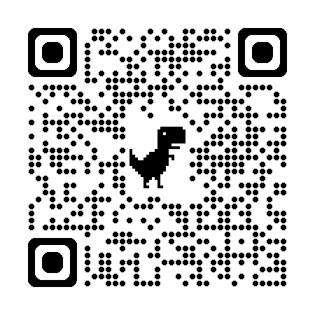
So far
Jurafsky’s Slide 17
Word-Sense Disambiguation
Concepts or word senses
Have a complex many-to-many association with words (homonymy, multiple senses)
Have relations with each other
Synonymy
Antonymy
Similarity
Relatedness
Connotation
Collocations
Collocations
Collocations
https://web.stanford.edu/~jurafsky/slp3/slides/vectorsemantics2024.pdf

Slide 8
Examples >> Definitions: “Erode” (George Miller: Chomsky’s Mentor, Magic Number 7, WordNet)
Exercise: Use “erode” in a sentence:
My family erodes a lot.
to eat into or away; destroy by slow consumption or disintegration
Battery acid had eroded the engine.
Inflation erodes the value of our money.
Miller’s Conclusion:
Dictionary examples are more helpful than definitions
Effective examples:
Make heavy use of collocations
Definition
Examples
6/27/2014
Fillmore Workshop
8

Slide 9
Computational Linguistics: An Interdisciplinary Combination of Engineering and Humanities
Engineering
Humanities & CogSci
Information Theory (Shannon)
Large Language Models (LLMs)
Bots: ChatGPT, DeepSeek
Linguistics
Psycholinguistics
Lexicography
Education
Testing: Vocabulary Size
Language Learning
Translation
Recent Excitement in AI

Slide 10
Narrative/Hype: LLMs are completely “new” But…
1950s: Empiricism
(Shannon, Skinner, Firth, Harris)
1970s: Rationalism
(Chomsky, Minsky)
1990s: Revival of empiricism
(IBM, AT&T Bell Labs)
2010s: Extreme empiricism
(LLMs, ChatGPT & DeepSeek)
Distributional Hypothesis
Zellig Harris (Chomsky’s Prof)
You shall know a word by the company it keeps
– Firth (1957)
Collocations

Slide 11

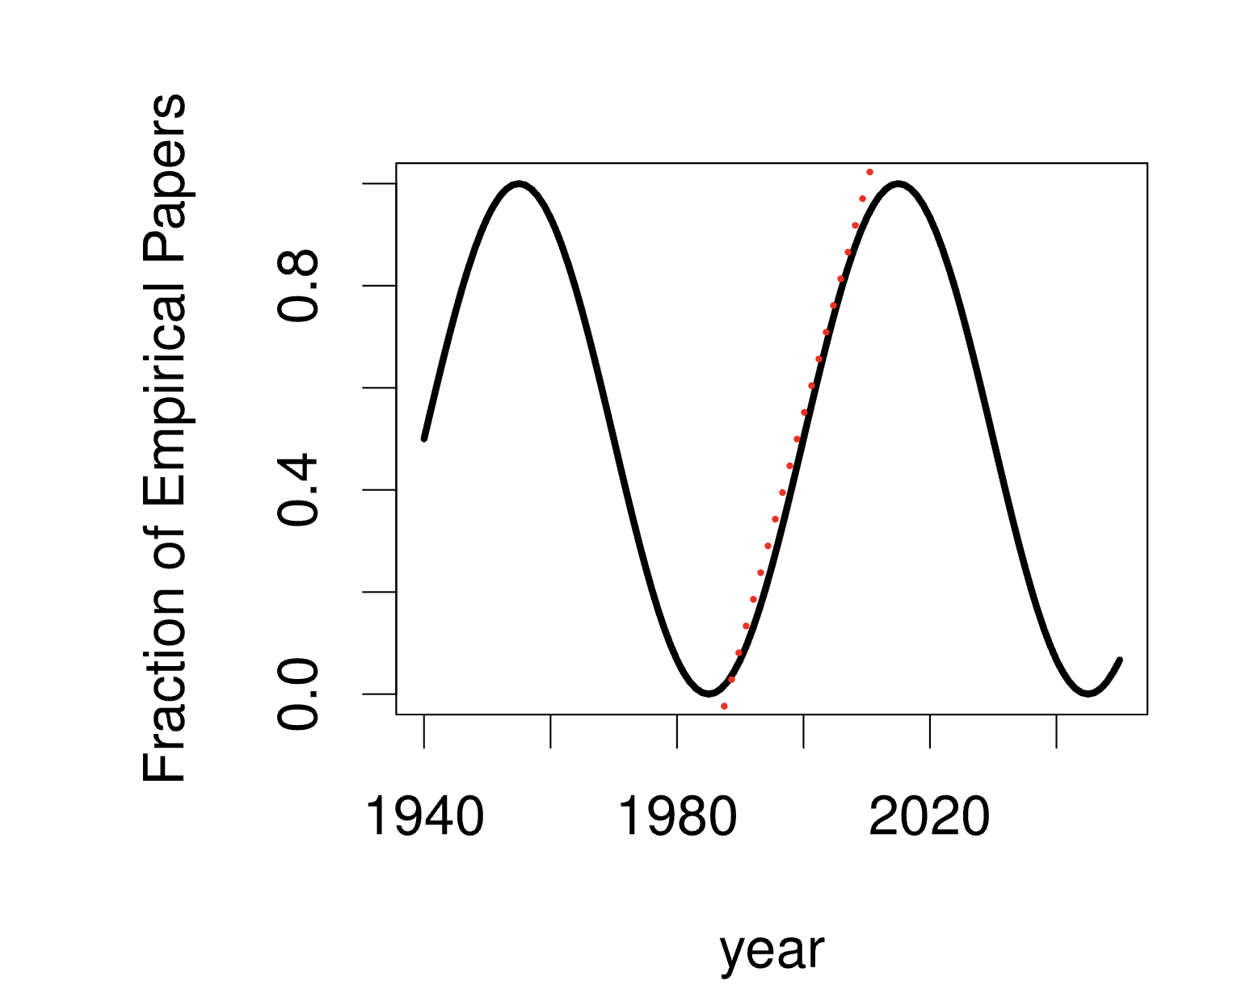
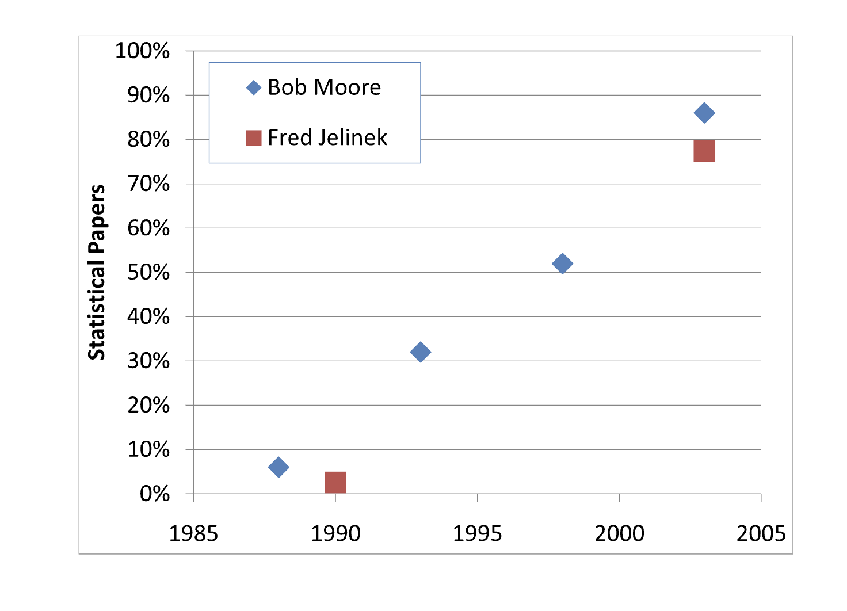
A Pendulum Swung Too Far Church, K. 2011. A Pendulum Swung Too Far. Linguistic Issues in Language Technology 6

Slide 12
Rationalism v. Empiricism (Grandparents and Grandchildren)
1950s: Empiricism
(Shannon, Skinner, Firth, Harris)
1970s: Rationalism
(Chomsky, Minsky)
1990s: Revival of empiricism
(IBM, AT&T Bell Labs)
2010s: Extreme empiricism
(LLMs, ChatGPT & DeepSeek)
You shall know a word by the company it keeps
– Firth (1957)
Every time I fire a linguist, the performance of the speech recognizer goes up
– Jelinek (2004)

Slide 13
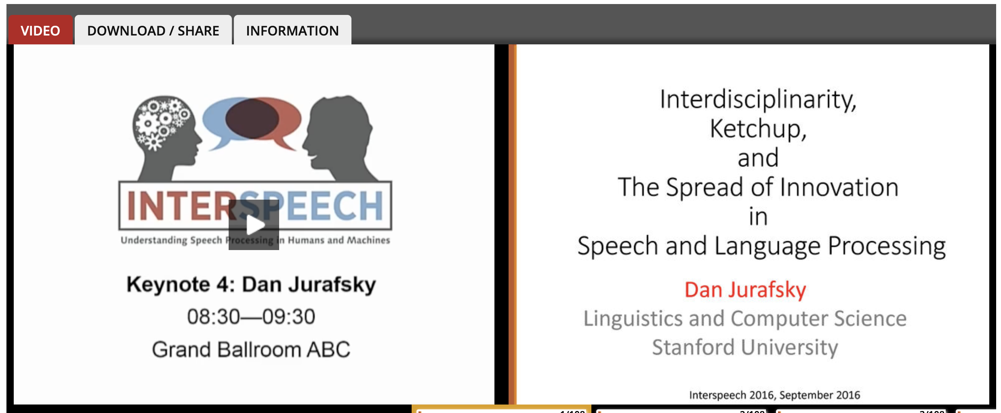

Jurafsky’s Spin on This History Jurafsky is author of Textbook (and “foodie”)

Slide 14
Topics to be discussed today
Motivations for PMI in
Lexicography (Hanks): Collocations
Engineering (Church): Bots
Use PMI as a foil to discuss
Past (1950s)
Psycholinguistics (Word Associations, Reaction Times)
Information Theory (Entropy, Perplexity)
Corpus-Based Methods (Lexicography → Engineering)
Future (Bots)
Vectors
Approximate Nearest Neighbors (ANN)

Slide 15
Corpus-Based Methods Lexicography → Engineering
Collect a sample of text (corpus)
Brown Corpus
British National Corpus (BNC)
Create Concordances
Also known as key word in context (KWIC)
Identify collocations
Organize concordances into patterns
Save <good> from <bad>

Slide 16
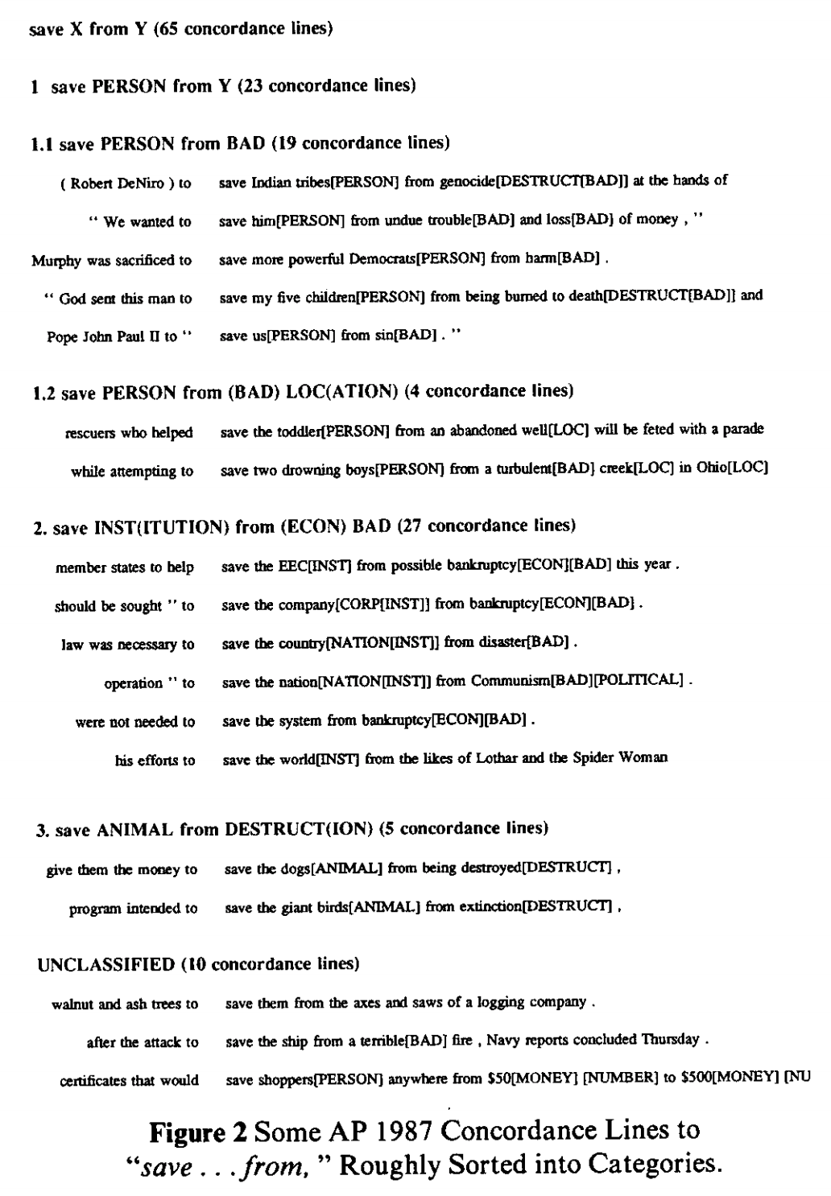
Save <good> from <bad>

Slide 17
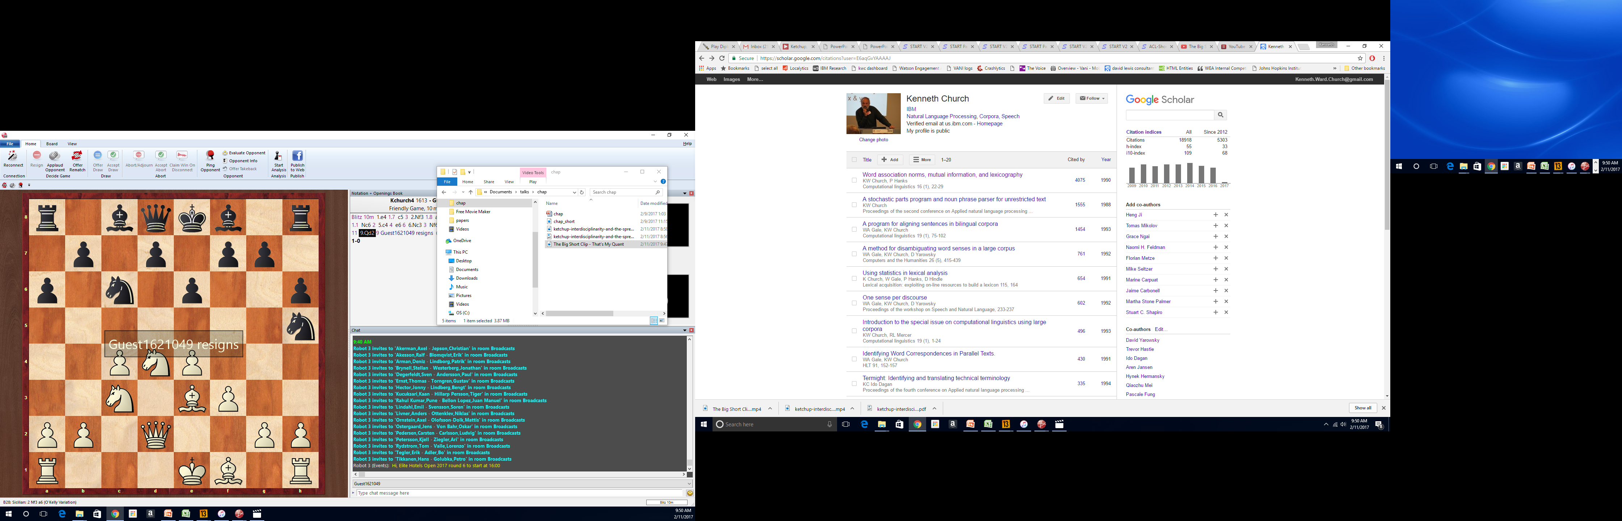
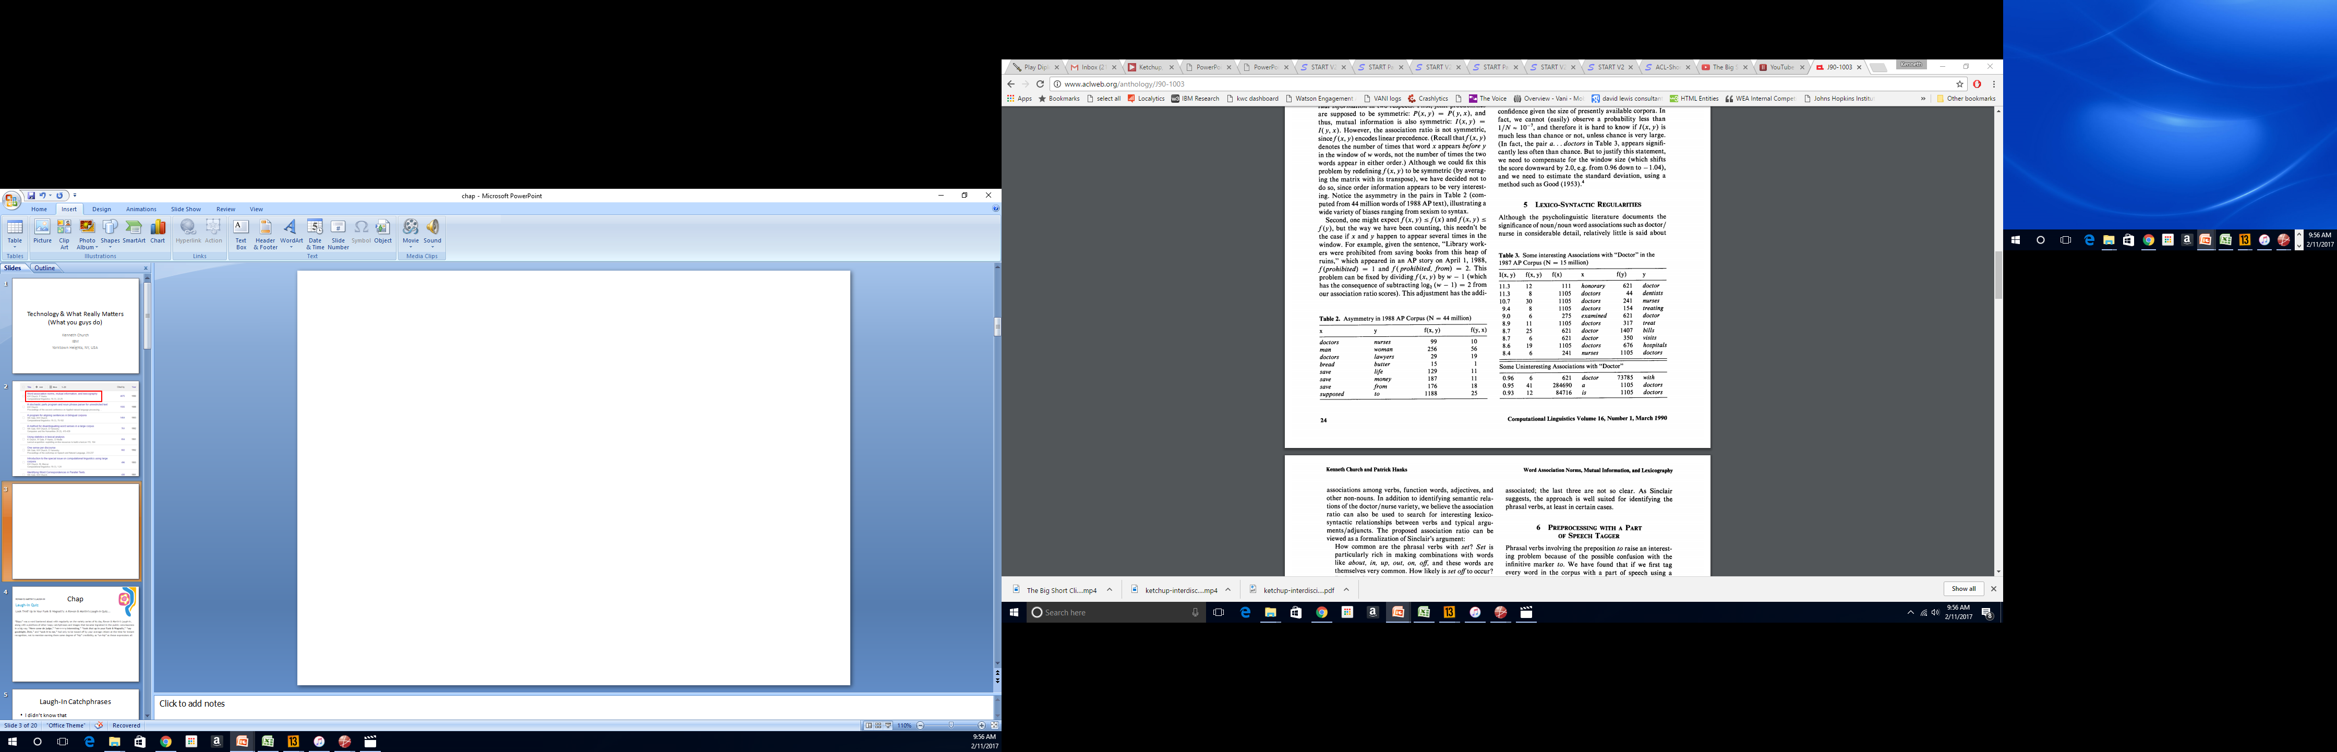
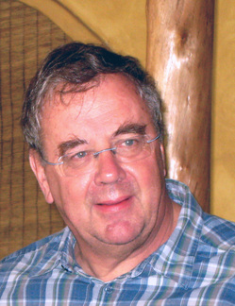

Slide 18
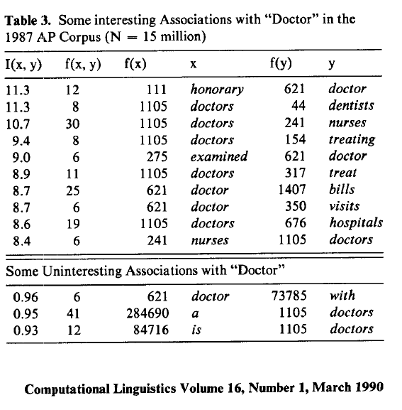
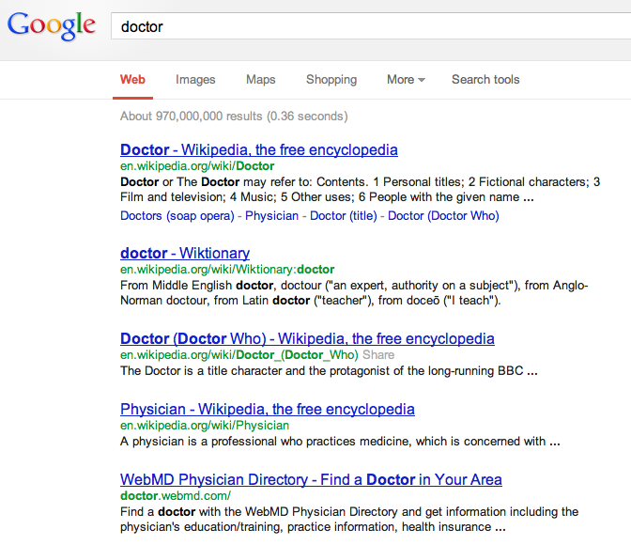
There is no data like more data
Counts are growing 1000x per decade
(same as disks)
Counts are growing 1000x per decade
(same as disks)
Rising Tide of Data Lifts All Boats

Slide 19


End-to-End Self-Organizing Systems v. Human-in-the-Loop
Collaboration with Hanks (PMI)
We always assumed
computer was in a supporting role.
It was my job to speed up drudgery
of reading concordances,
but it was not my job
to automate his job.
He loved most of what he did,
though he was happy to work with me to automate a few unpleasant chores,
so he could spend more time on the parts of his job that he truly enjoyed.
I am concerned that we are too carried away with the upsides
Too much talk about firing linguists,
and replacing historians like Platt and
lexicographers like Hanks with automation.
Bots can already do many things,
and they will get better,
but bots cannot – and should not attempt to – do more than they can do.

Slide 20
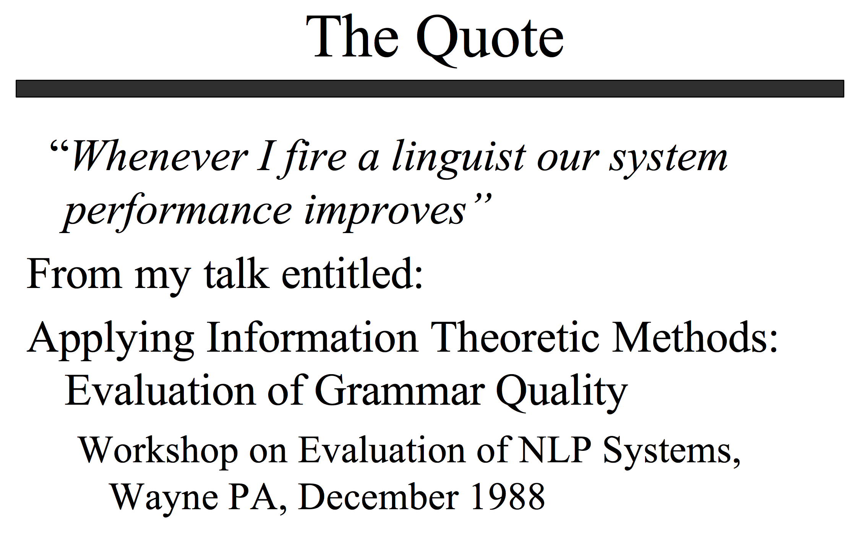
http://www.lrec-conf.org/lrec2004/doc/jelinek.pdf

Slide 21
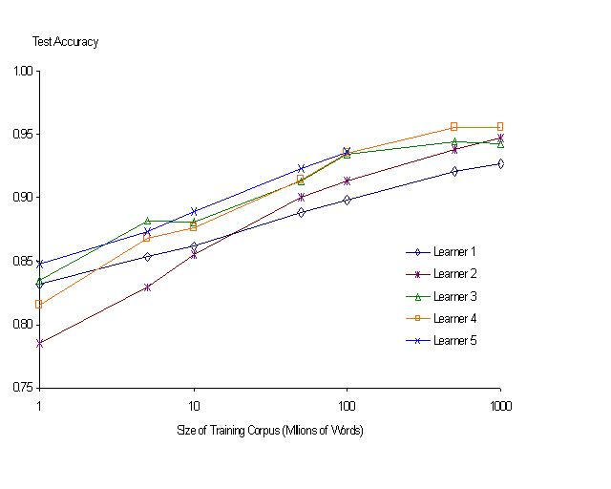
“It never pays to think until you’ve run out of data” – Eric Brill
Moore’s Law Constant:
Data Collection Rates → Improvement Rates
Banko & Brill: Mitigating the Paucity-of-Data Problem (HLT 2001)
No consistently
best learner
There is no data like more data
Quoted out of context
Fire everybody and
spend the money on data

Slide 22
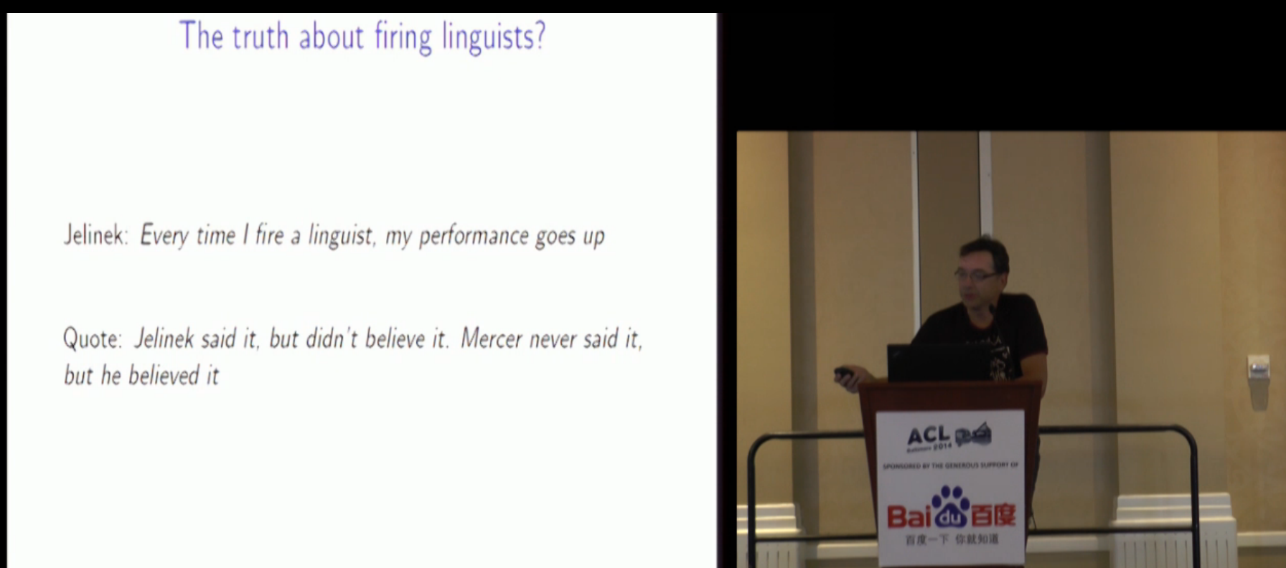
Robert Mercer ACL Lifetime Achievement http://techtalks.tv/talks/closing-session/60532/

Slide 23
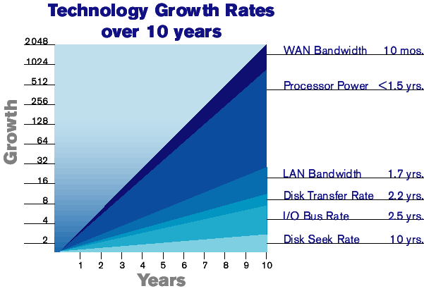

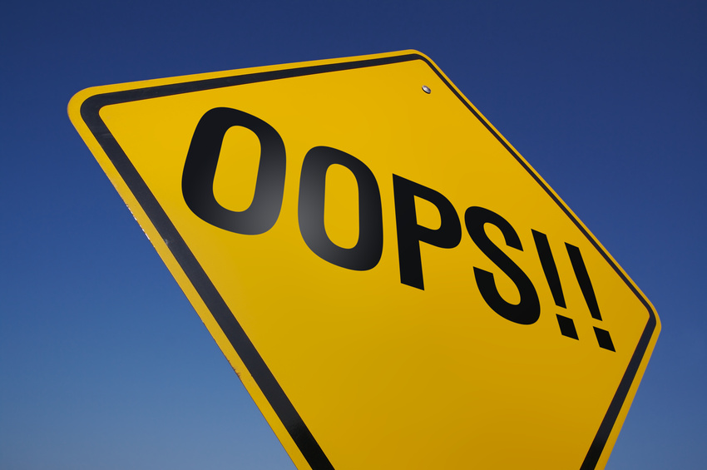
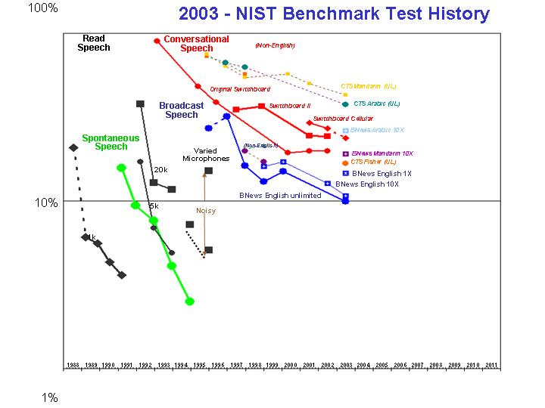
The Disk Space Conjecture
Improvements in Speech, Language (& more)
are indexed to improvements in disk capacities
because disk prices → size of web → training data
2003 Prediction:
Disks improve1000x per decade
1TB: $1k (2003) → $1 (2013)
Missed by 30x (a TB is currently ~ $30 >> $1)

Slide 24
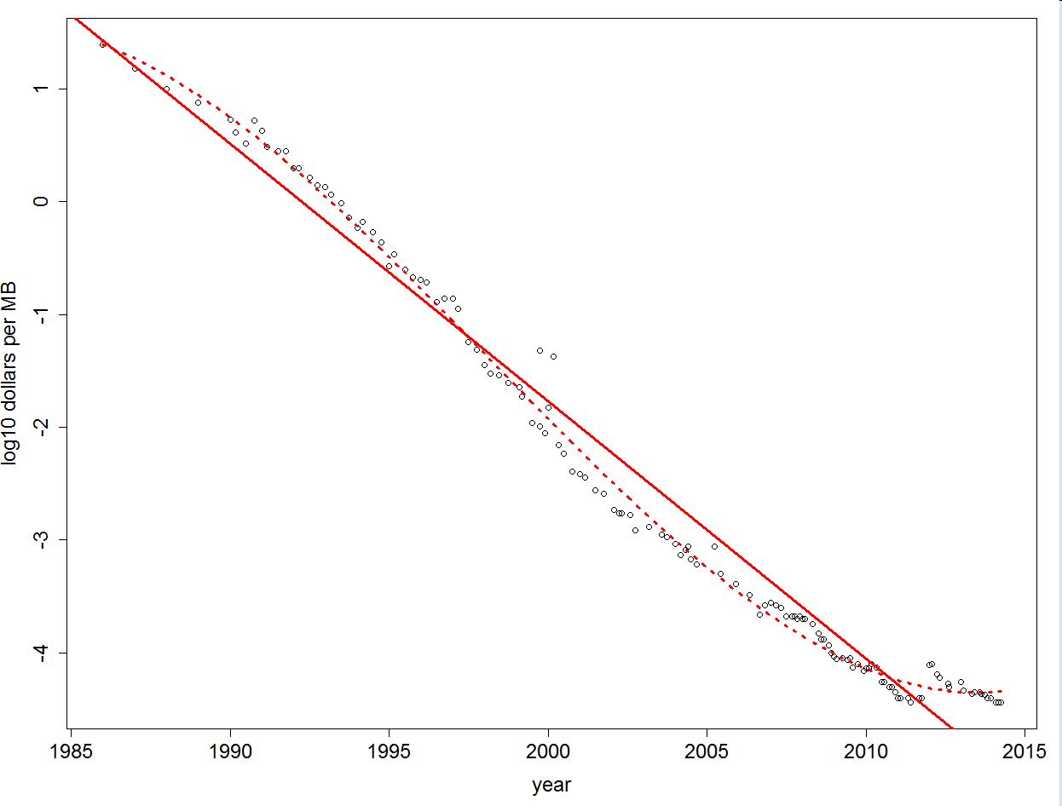
Disk Prices Over 30 Years http://www.jcmit.com/diskprice.htm
191x cheaper per decade (1985-2014)
1750x cheaper per decade (1995-2003)
Flood

Slide 25
Moore’s Law: Different Time Constants for Different Things https://archive.is/3pgVP

Slide 26
Word Association Norms: Doctor / Nurse
Counts are growing 1000x per decade
(same as disks)
Counts are growing 1000x per decade
(same as disks)
Rising Tide of Data Lifts All Boats

Slide 27
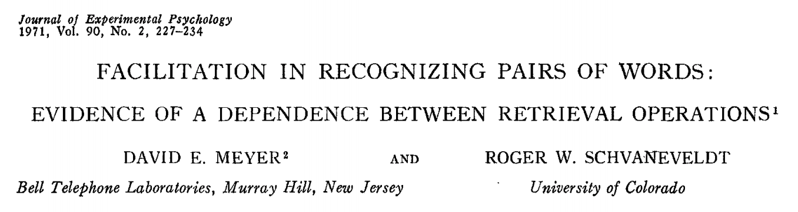
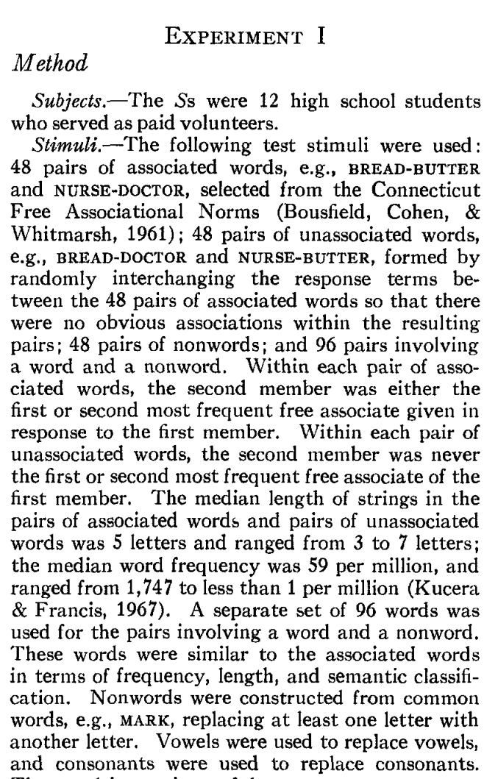
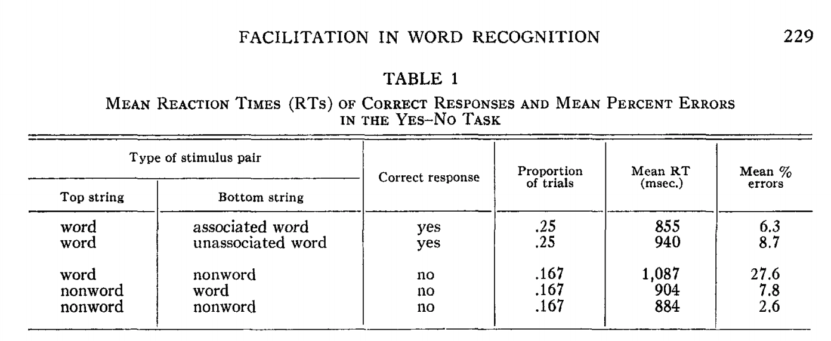
Priming & Word Associations Task: Subject is given two strings and responds “yes” if both are words

Slide 28
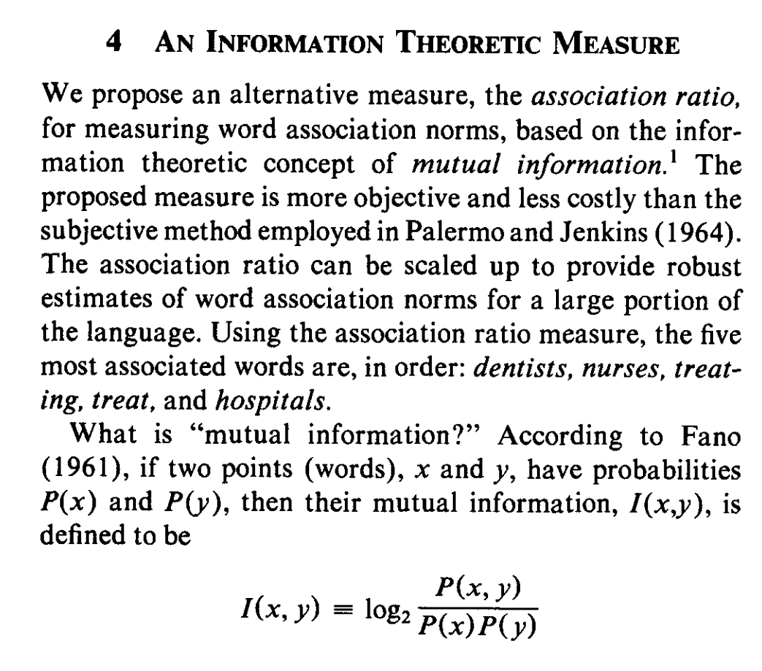
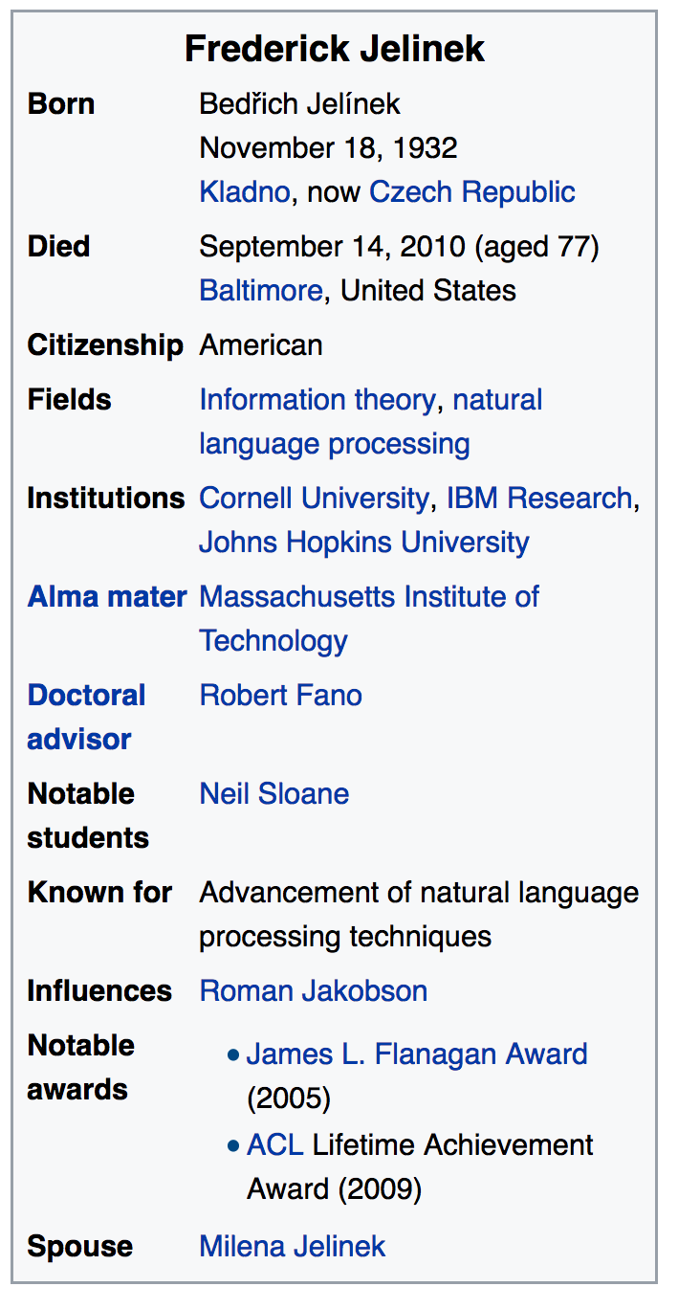
Pointwise Mutual Information (PMI)
Simple interpretation
PMI compares P(x,y) with chance
Chance = P(x) P(y)
If there is a genuine association
then P(x,y) >> P(x) P(y)
Uninteresting associations
P(x,y) ≈ P(x) P(y)
Popular applications (lexicography)
more like hypothesis testing
focus on largest PMI
where we can reject null hypothesis
null hypo: uninteresting
less like language modeling for speech and machine translation

Slide 29
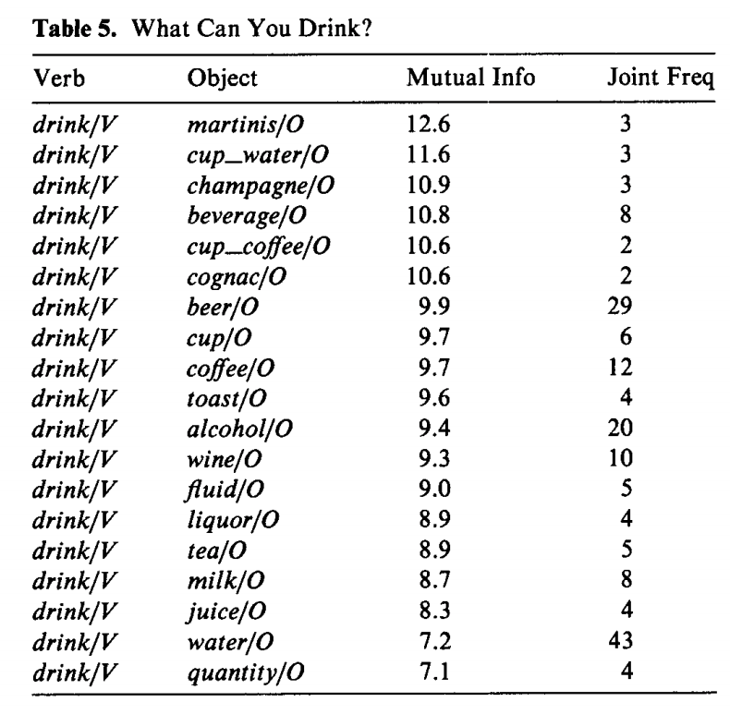
Windows for computing P(x,y)
Bigrams:
rectangular window with width of 1 word
Ngrams
rectangular window with width of n-1 words
More generally
Windows need not be rectangular
Or symmetric around 0
(Mutual Information is symmetric
but “Association Measure” is not)
Convenient to assume windows sum to 1
More interesting windows
Parse Trees / SVO

Slide 30
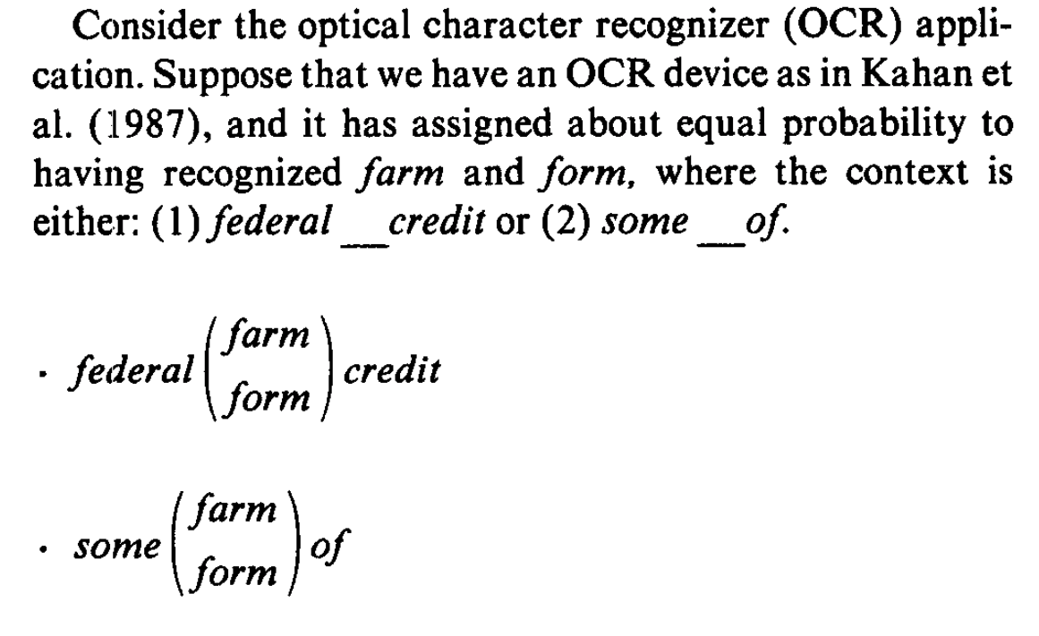
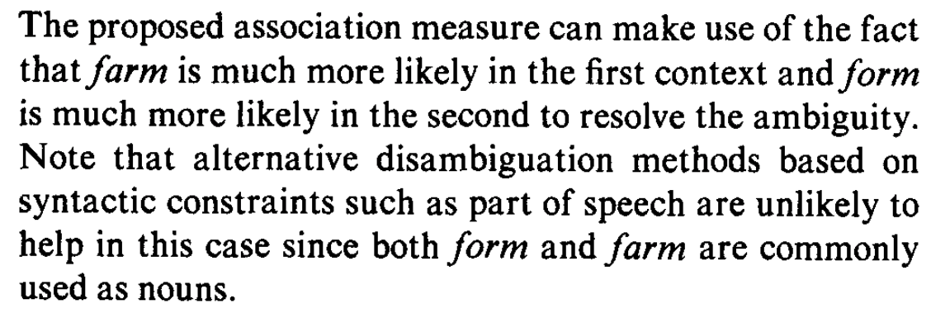
OCR Application

Slide 31
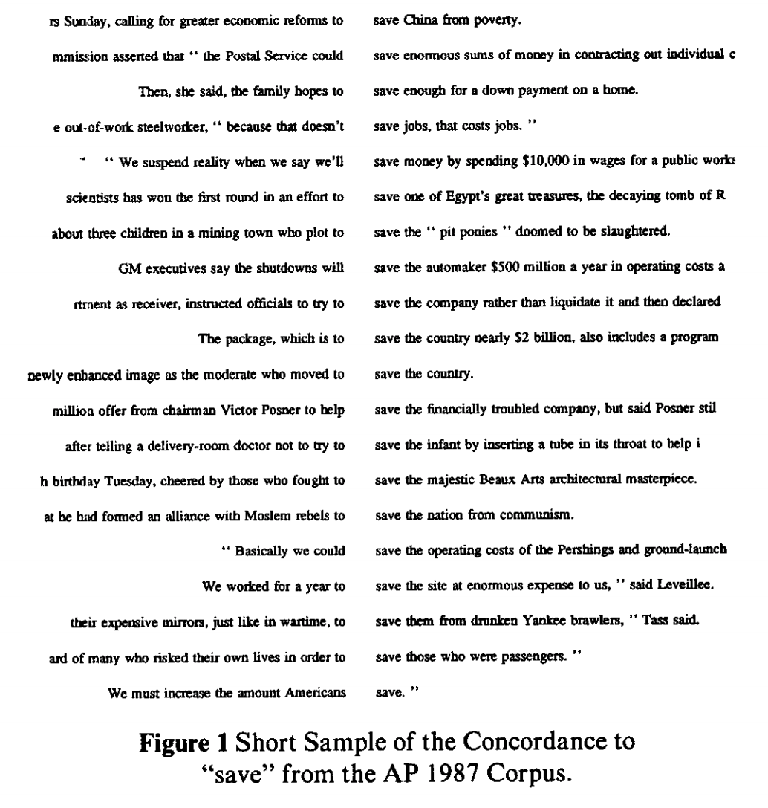
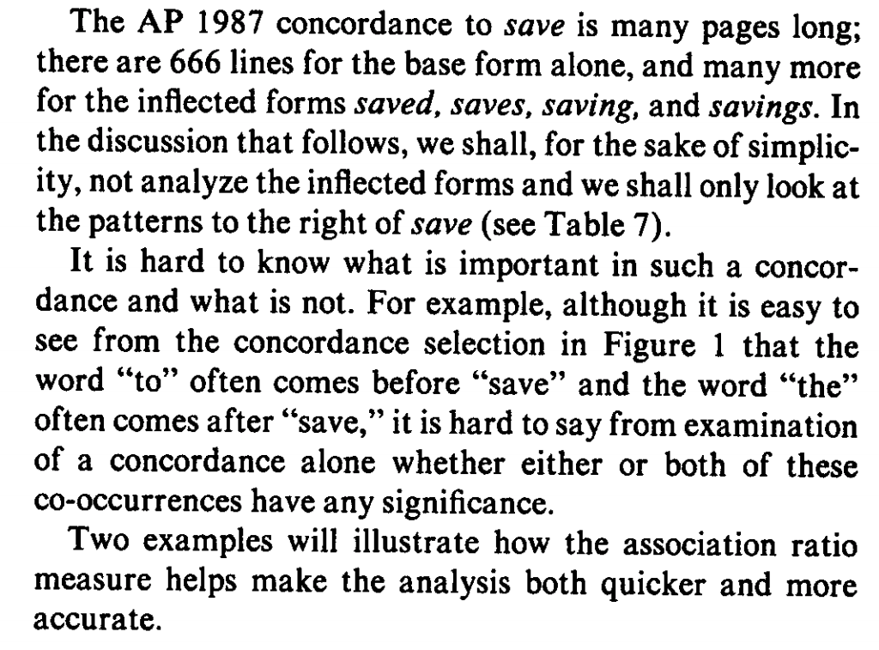
Applications in Lexicography

Slide 32
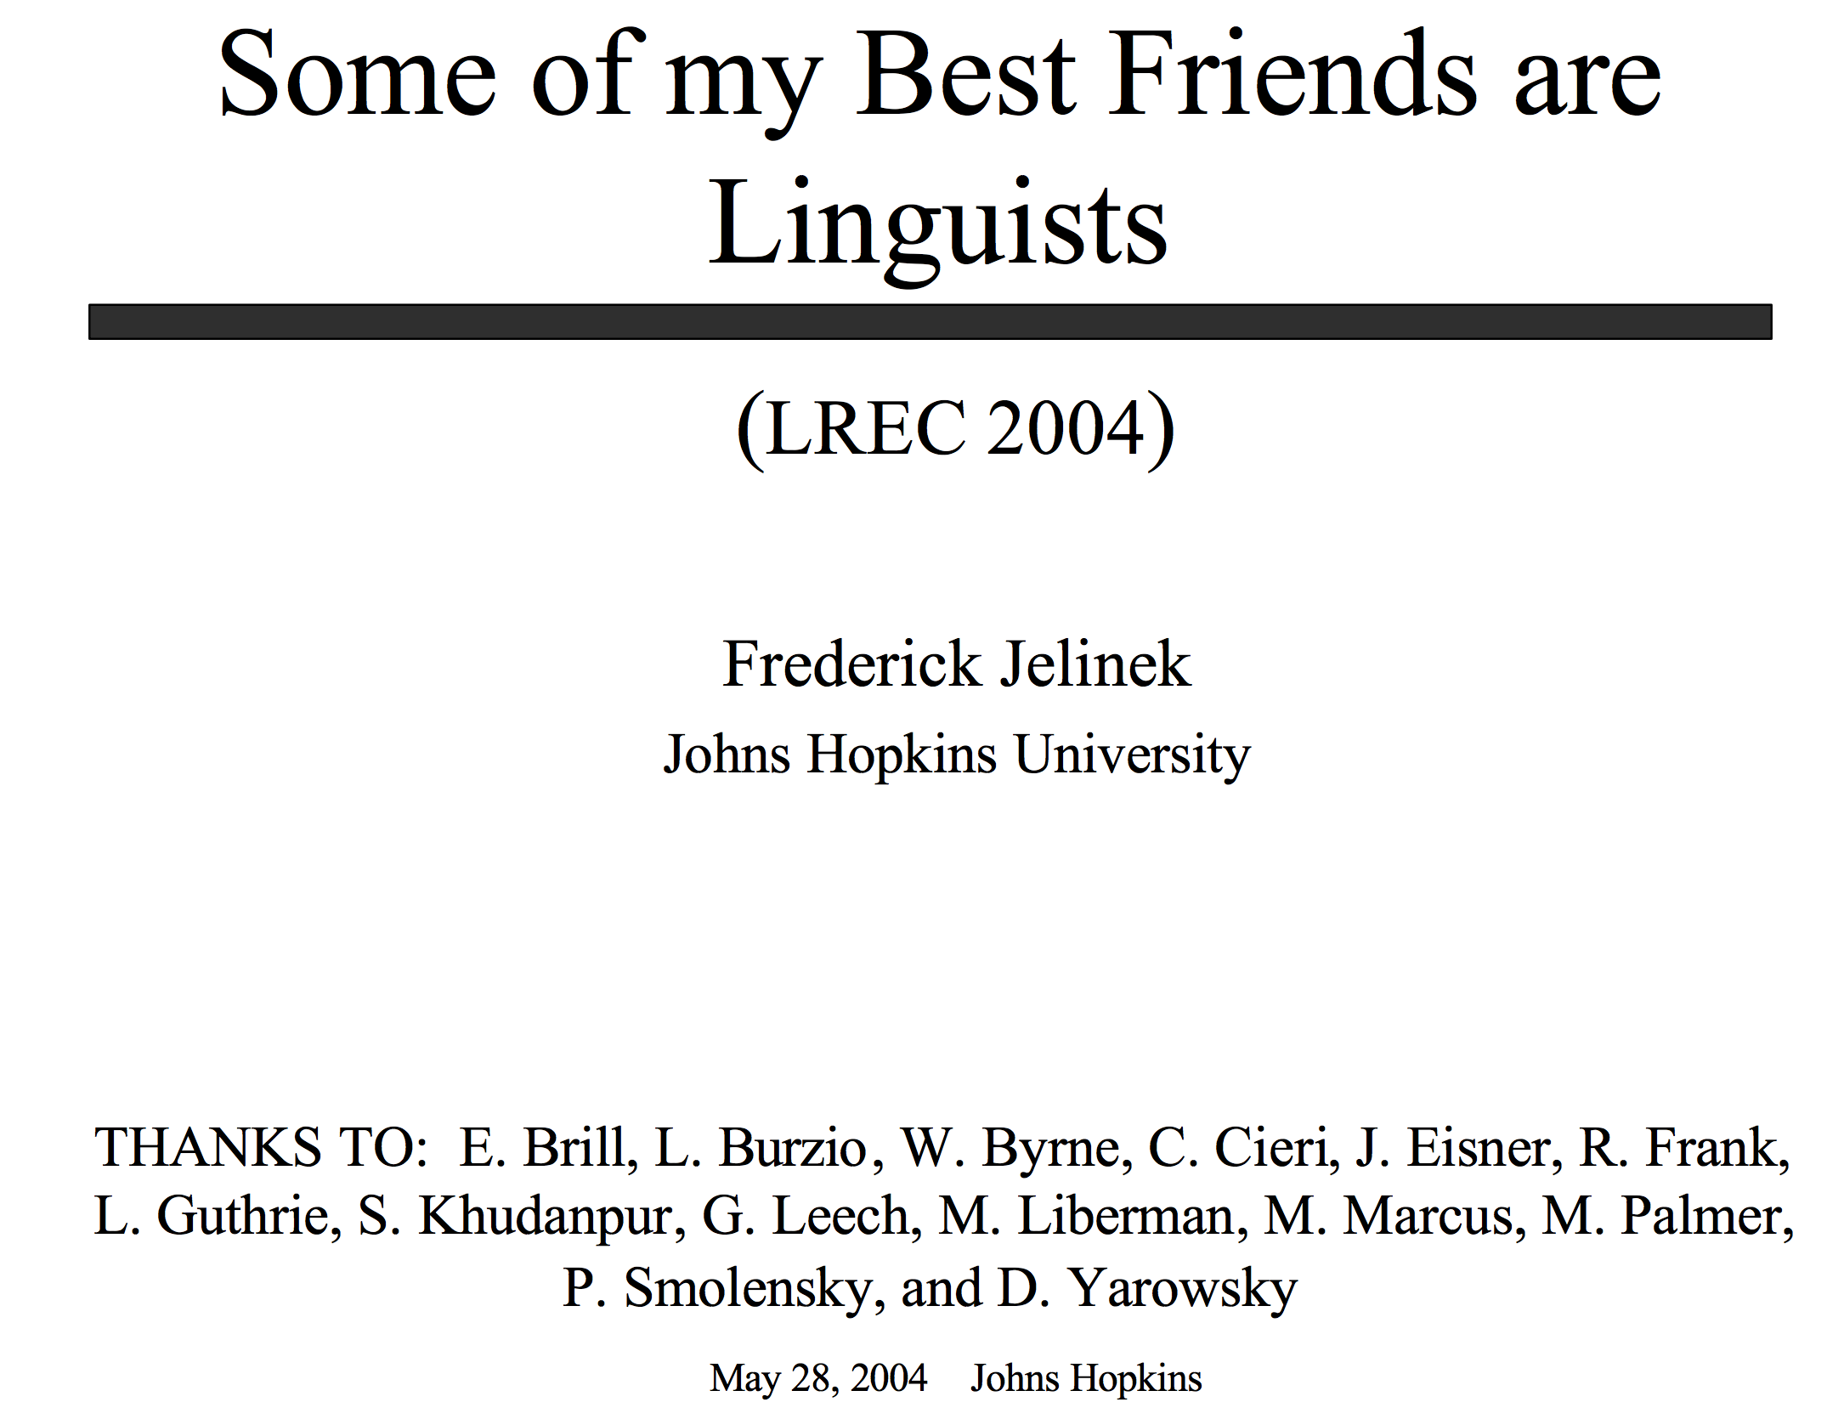
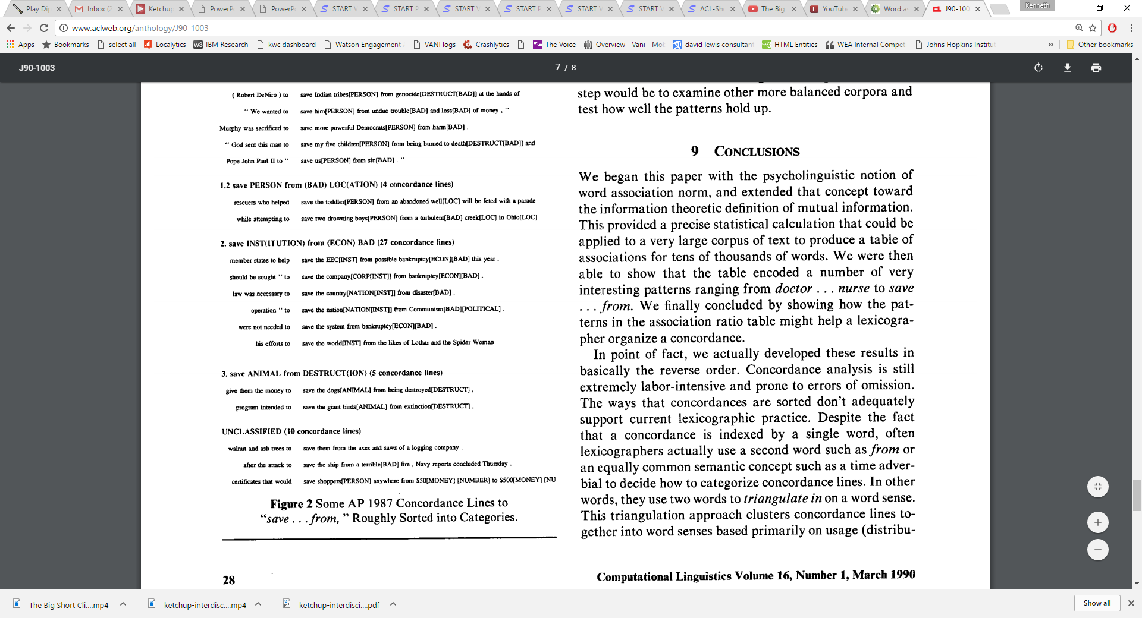
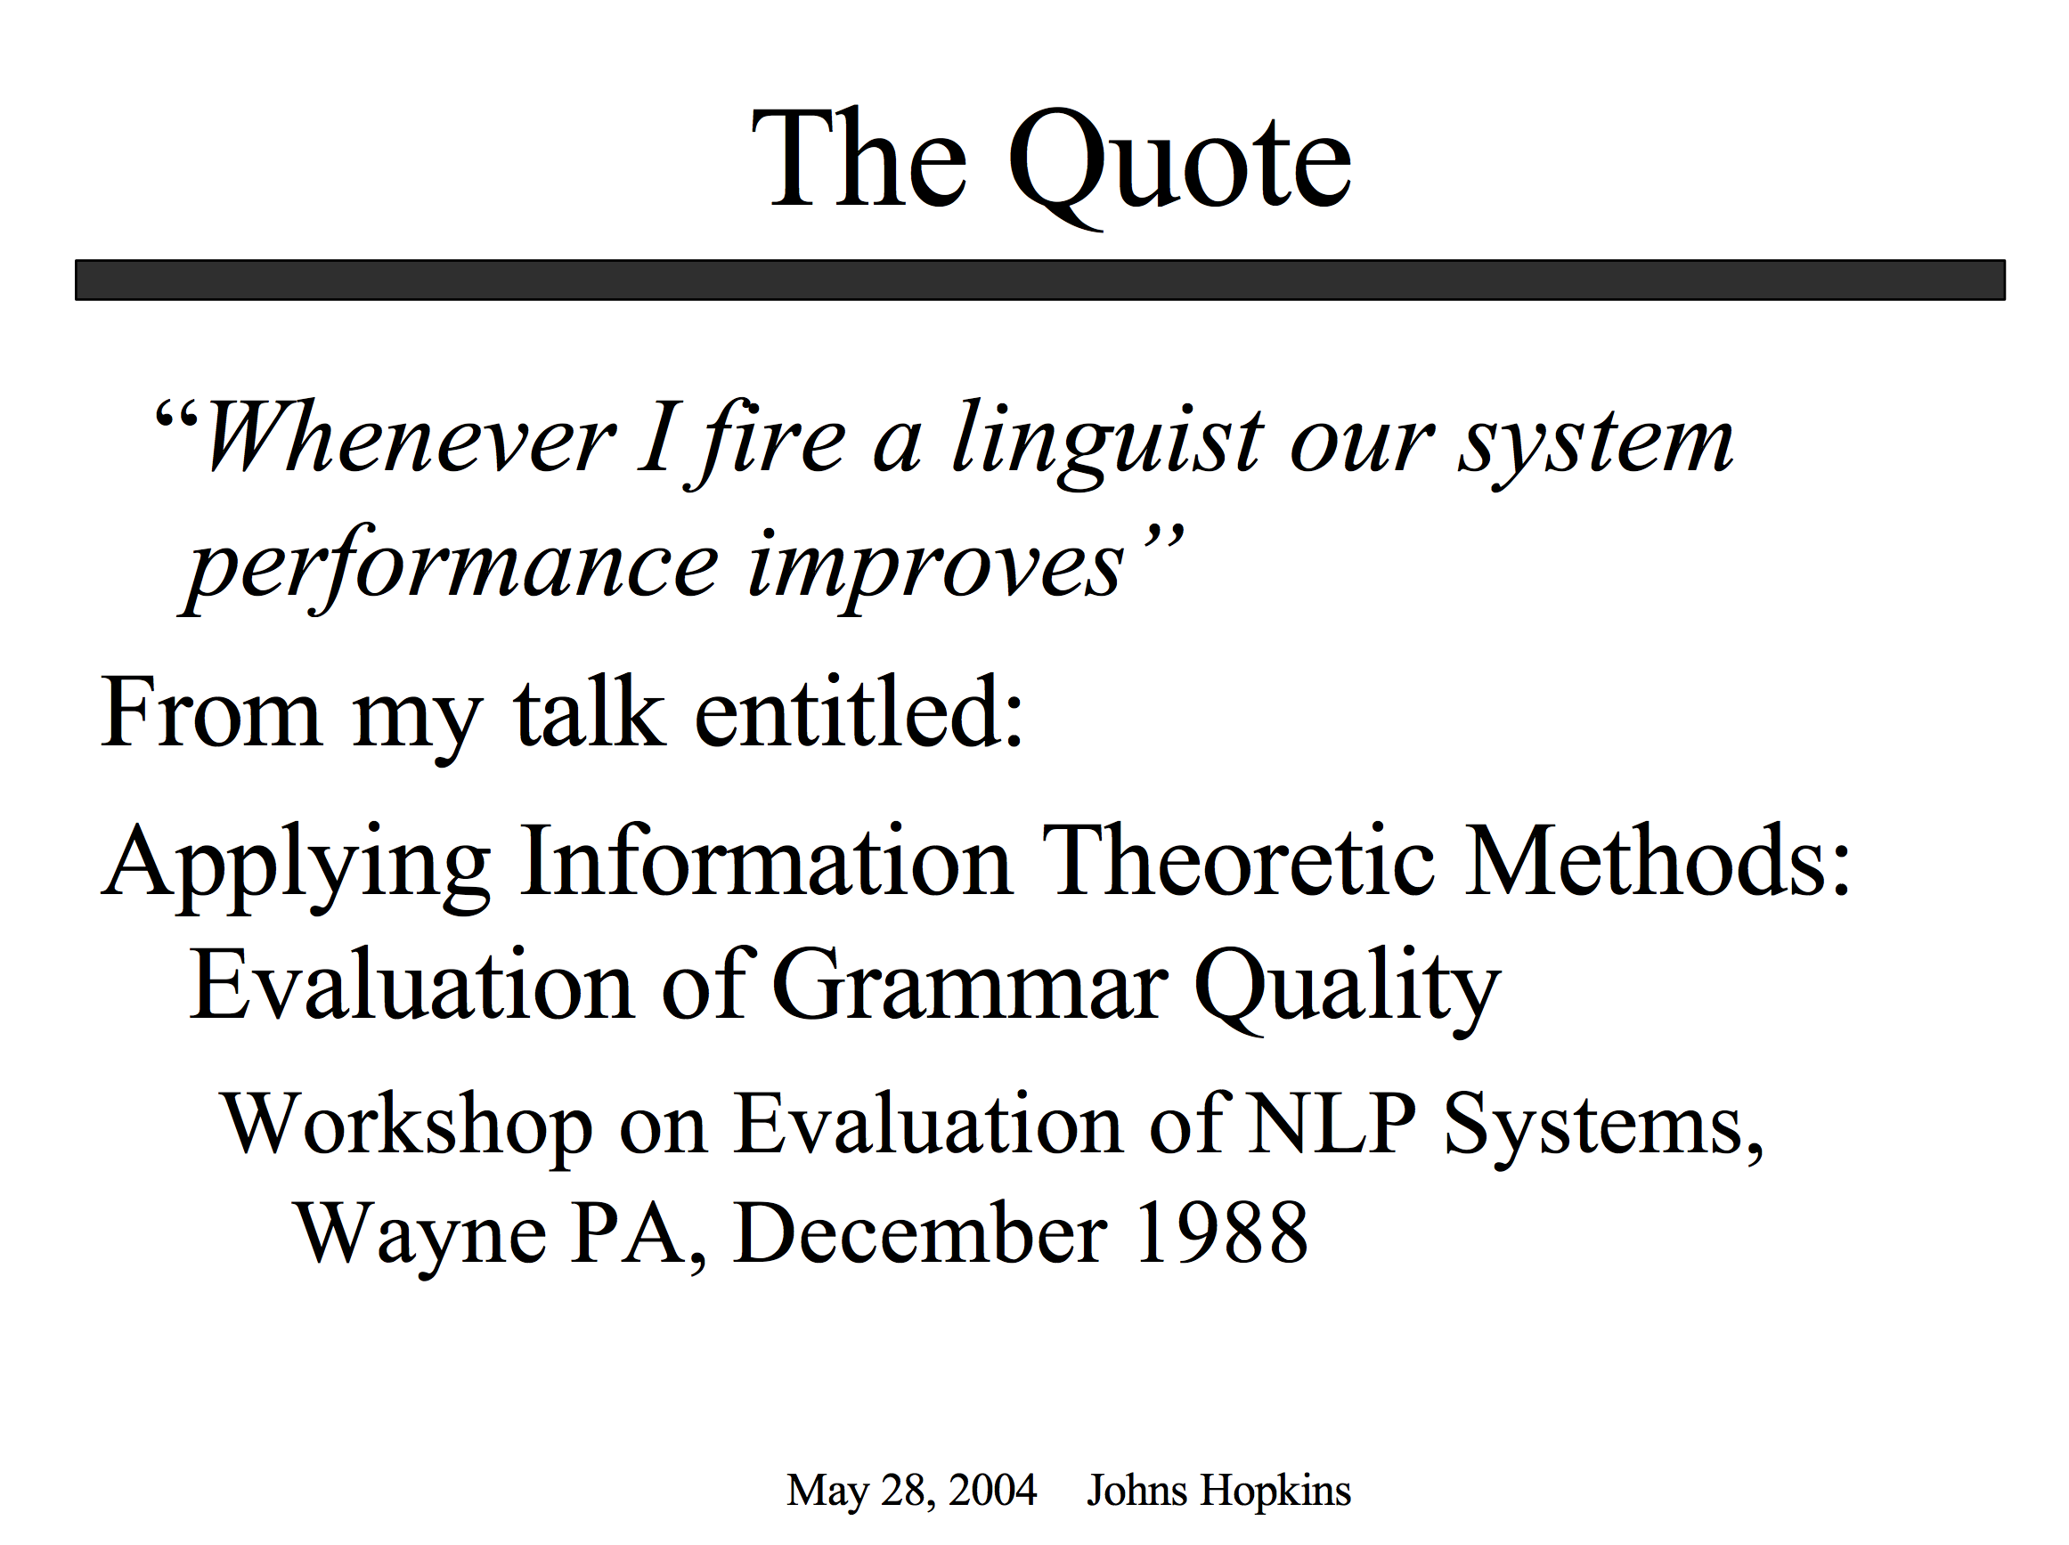
Proper Place for Automation: Start with Drudgery (Support our colleagues; don’t talk too much about taking away jobs they love to do)

Slide 33
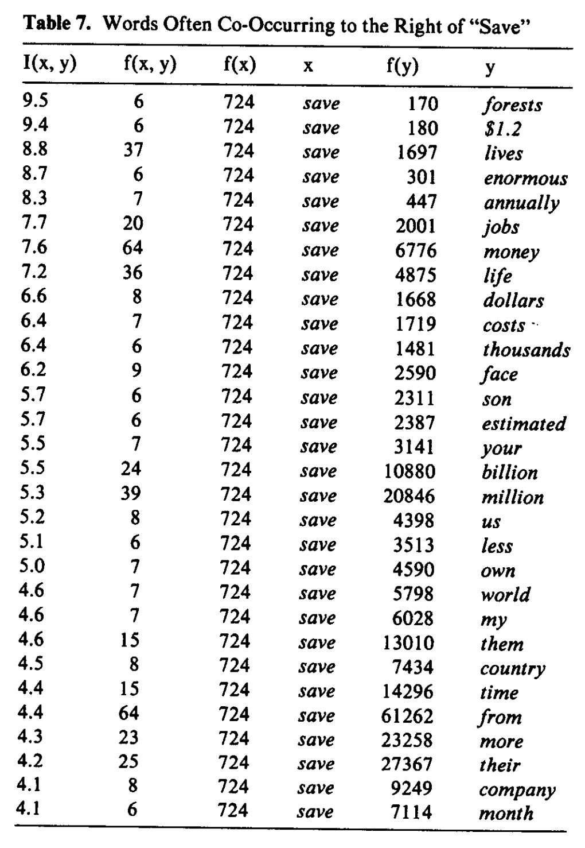
Patrick found tables like this very exciting

Slide 34
Save <good> from <bad>

Slide 35
Save good shoppers from their evil $$
Patrick wanted me to “fix” my bug

Slide 36
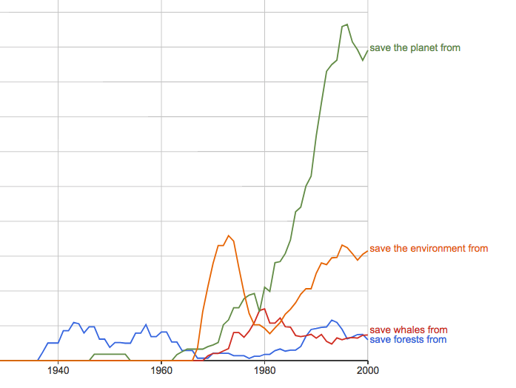
https://books.google.com/ngrams/graph?content=save+forests+from%2Csave+whales+from%2Csave+the+planet+from%2Csave+the+environment+from&year_start=1800&year_end=2000&corpus=15&smoothing=3&share=&direct_url=t1%3B%2Csave%20forests%20from%3B%2Cc0%3B.t1%3B%2Csave%20whales%20from%3B%2Cc0%3B.t1%3B%2Csave%20the%20planet%20from%3B%2Cc0%3B.t1%3B%2Csave%20the%20environment%20from%3B%2Cc0
Google Ngrams

Slide 37
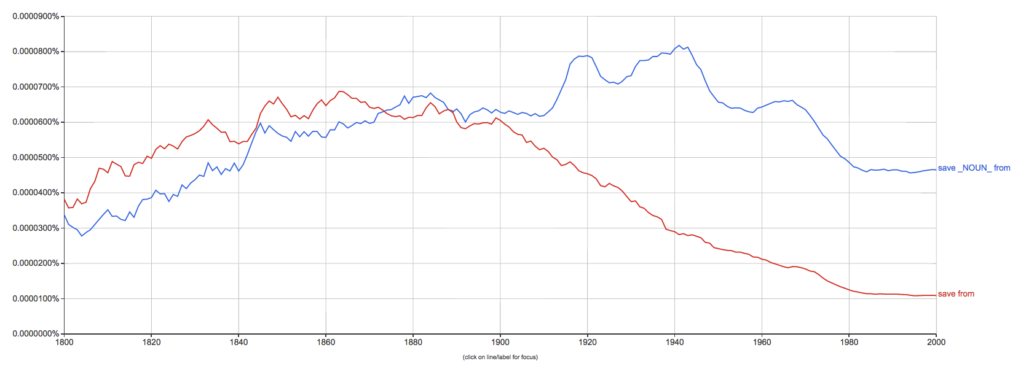
save from ≠ save X from Y

Slide 38
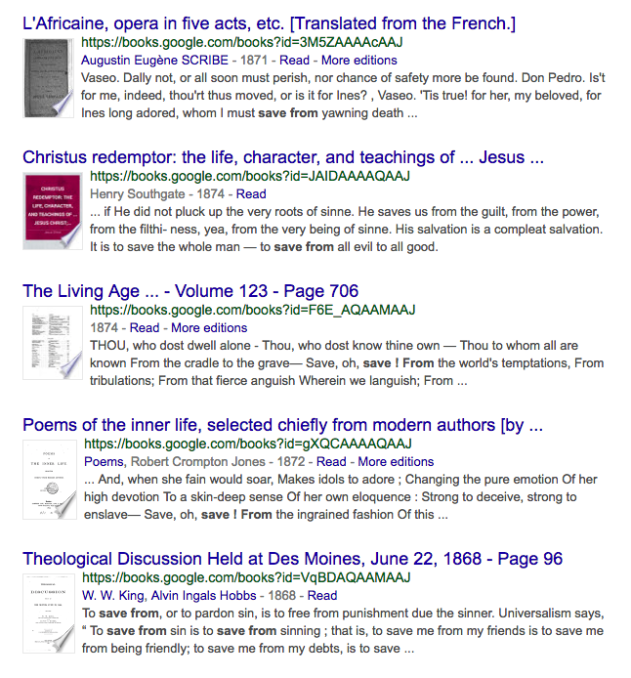
save from ≠ save X from Y

Slide 40
Plan
Summarize main points of paper
Call out
some highlights of subsequent literature
suggestions for future work

Slide 41
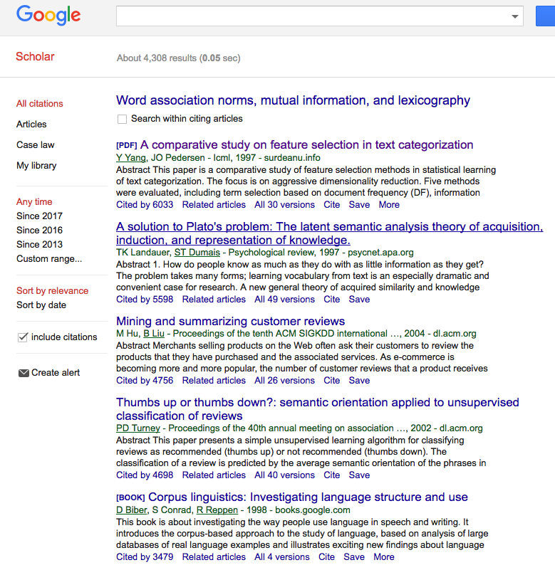
Using Google Scholar to find subsequent work to call out
Text Classification
LSA
Sentiment
Sentiment
Lexicography

Slide 42
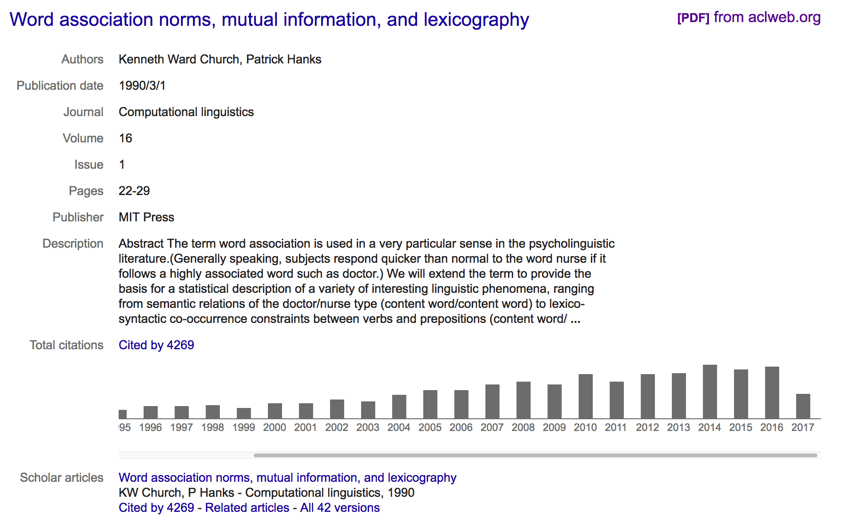
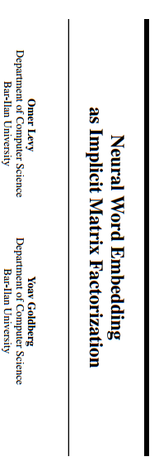
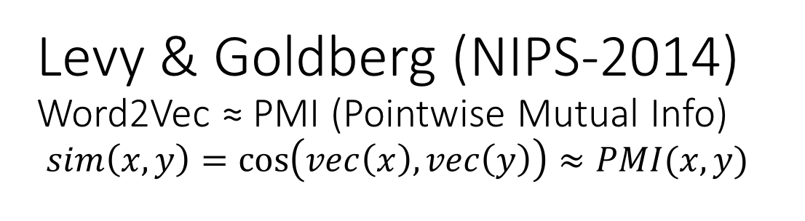
Levy & Goldberg (NIPS-2014) Word2Vec ≈ PMI (Pointwise Mutual Info) $sim\left(x,y\right)=\cos\left(vec\left(x\right), vec\left(y\right)\right)≈PMI(x,y)$
What happened in 2014?

Slide 43
Word2vec is popular (massively cited)
Word2vec is not first, last or best to discuss
Vector spaces, embeddings, analogies, similarity metrics, etc.
But word2vec is simple and accessible
Anyone can download the code and use it in their next paper.
Any many do (for better and for worse)
Available downloads
Pre-computed vectors (no training required)
Code for training your own vectors on your own corpora

Slide 44
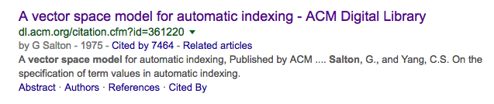
Salton’s Vector Space Model

Slide 45
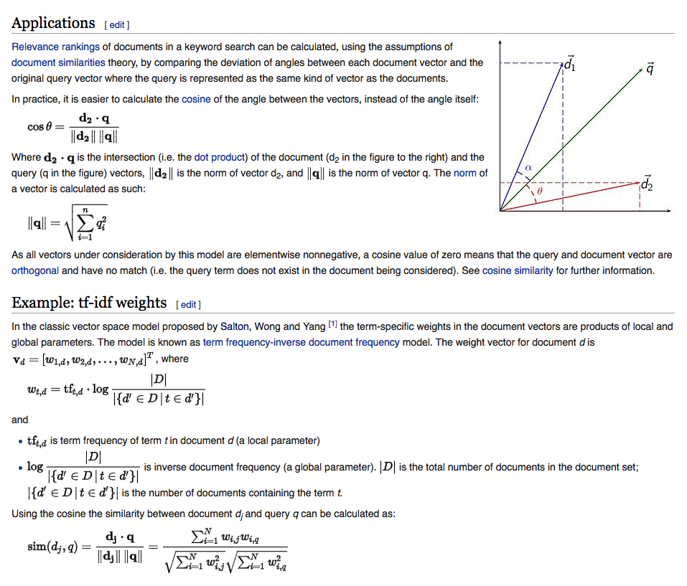
Embeddings: Similarity of docs/words ≈ cos (dot product)

Slide 46
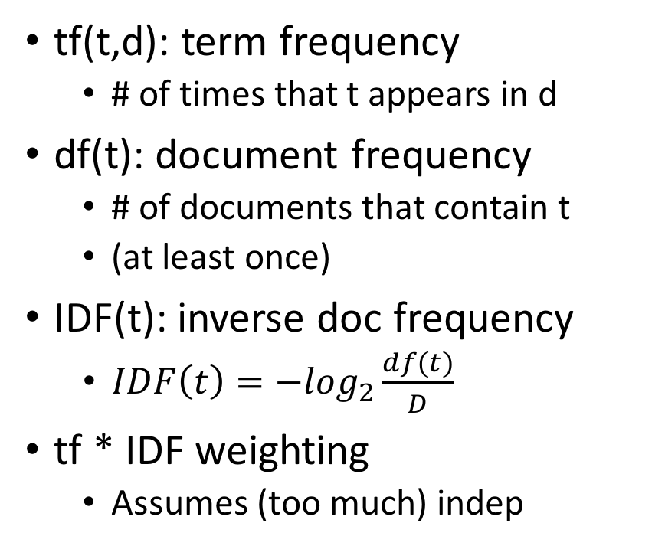
Information Retrieval (IR) notation Term Weighting: tf * IDF
t: term
d: document
D: # of documents in library
tf(t,d): term frequency
# of times that t appears in d
df(t): document frequency
# of documents that contain t
(at least once)
IDF(t): inverse doc frequency
$IDF\left(t\right)=−\log_{2}\frac{df(t)}{D}$
tf * IDF weighting
Assumes (too much) indep

Slide 48


LSA/LSI: Latent Semantic Analysis/Indexing SVD: Singular Value Decomposition PCA: Principal Component Analysis
 | c1 | c2 | c3 | c4 | c5 | m1 | m2 | m3 | m4
human | 1 | 0 | 0 | 1 | 0 | 0 | 0 | 0 | 0
interface | 1 | 0 | 1 | 0 | 0 | 0 | 0 | 0 | 0
computer | 1 | 1 | 0 | 0 | 0 | 0 | 0 | 0 | 0
user | 0 | 1 | 1 | 0 | 1 | 0 | 0 | 0 | 0
system | 0 | 1 | 1 | 2 | 0 | 0 | 0 | 0 | 0
response | 0 | 1 | 0 | 0 | 1 | 0 | 0 | 0 | 0
time | 0 | 1 | 0 | 0 | 1 | 0 | 0 | 0 | 0
EPS | 0 | 0 | 1 | 1 | 0 | 0 | 0 | 0 | 0
survey | 0 | 1 | 0 | 0 | 0 | 0 | 0 | 0 | 1
trees | 0 | 0 | 0 | 0 | 0 | 1 | 1 | 1 | 0
graph | 0 | 0 | 0 | 0 | 0 | 0 | 1 | 1 | 1
minors | 0 | 0 | 0 | 0 | 0 | 0 | 0 | 1 | 1
M: term by doc matrix
$M≈UDV^{T}$
Dimension Reduction
s = svd(m)
m2 = s$u[,1:2] %*% diag(s$d[1:2]) %*% t(s$v[,1:2])
dimnames(m2)=dimnames(m)
Bellcore Example

Slide 49


Slide 50


plot(hclust(as.dist(1-cor(m)))
 | c1 | c2 | c3 | c4 | c5 | m1 | m2 | m3 | m4
human | 1 | 0 | 0 | 1 | 0 | 0 | 0 | 0 | 0
interface | 1 | 0 | 1 | 0 | 0 | 0 | 0 | 0 | 0
computer | 1 | 1 | 0 | 0 | 0 | 0 | 0 | 0 | 0
user | 0 | 1 | 1 | 0 | 1 | 0 | 0 | 0 | 0
system | 0 | 1 | 1 | 2 | 0 | 0 | 0 | 0 | 0
response | 0 | 1 | 0 | 0 | 1 | 0 | 0 | 0 | 0
time | 0 | 1 | 0 | 0 | 1 | 0 | 0 | 0 | 0
EPS | 0 | 0 | 1 | 1 | 0 | 0 | 0 | 0 | 0
survey | 0 | 1 | 0 | 0 | 0 | 0 | 0 | 0 | 1
trees | 0 | 0 | 0 | 0 | 0 | 1 | 1 | 1 | 0
graph | 0 | 0 | 0 | 0 | 0 | 0 | 1 | 1 | 1
minors | 0 | 0 | 0 | 0 | 0 | 0 | 0 | 1 | 1

Slide 51

plot(hclust(as.dist(1-cor(t(m))))
 | c1 | c2 | c3 | c4 | c5 | m1 | m2 | m3 | m4
human | 1 | 0 | 0 | 1 | 0 | 0 | 0 | 0 | 0
interface | 1 | 0 | 1 | 0 | 0 | 0 | 0 | 0 | 0
computer | 1 | 1 | 0 | 0 | 0 | 0 | 0 | 0 | 0
user | 0 | 1 | 1 | 0 | 1 | 0 | 0 | 0 | 0
system | 0 | 1 | 1 | 2 | 0 | 0 | 0 | 0 | 0
response | 0 | 1 | 0 | 0 | 1 | 0 | 0 | 0 | 0
time | 0 | 1 | 0 | 0 | 1 | 0 | 0 | 0 | 0
EPS | 0 | 0 | 1 | 1 | 0 | 0 | 0 | 0 | 0
survey | 0 | 1 | 0 | 0 | 0 | 0 | 0 | 0 | 1
trees | 0 | 0 | 0 | 0 | 0 | 1 | 1 | 1 | 0
graph | 0 | 0 | 0 | 0 | 0 | 0 | 1 | 1 | 1
minors | 0 | 0 | 0 | 0 | 0 | 0 | 0 | 1 | 1

Slide 52


LSA maps terms & docs into internal dimensions

Slide 53
Word2vec is popular (massively cited)
Word2vec is not first, last or best to discuss
Vector spaces, embeddings, analogies, similarity metrics, etc.
But word2vec is simple and accessible
Anyone can download the code and use it in their next paper.
Any many do (for better and for worse)
Available downloads
Pre-computed vectors (no training required)
Code for training your own vectors on your own corpora

Slide 54


Word2Vec: $sim\left(x,y\right)=\cos\left(vec\left(x\right), vec\left(y\right)\right)≈PMI(x,y)$ https://code.google.com/archive/p/word2vec/
Linguistic generalizations
Word associations (distance in plot)
Features (red line)
Countries & Capitals
Analogies:
Man : Woman :: King : x
x → queen
Athens : Greece :: Bangkok: x
x → Thailand
Vector Space (Salton)
Addition & subtraction
Clustering, PCA
Convenient for Neural Networks

Slide 55


man : woman :: king : x
Vector addition & subtraction
$vec\left(king+woman −man\right)=vec\left(king\right)+vec\left(woman\right)−vec(man)$
Analogies
$\hat{x}=\underset{x∈V}{ARGMAX}{sim(x^{′}, king+woman −man)}$

Slide 56

Some analogies are easier than others
Tweets
RT @tallinzen: sure, king:queen etc, but did you know word2vec gets real SAT analogies right just 1% of the time?
15 copies of this tweet
Some by NLP experts
Resources Debate
WordNet &
British National Corpora

Slide 57

Levy & Goldberg (NIPS-2014) Word2Vec ≈ PMI (Pointwise Mutual Info)
Levy & Goldberg (NIPS-2014) is a theoretical arg
Plots → correlations are large, but far from perfect
Materials:
N = 22 words (11 cities + 11 countries)
N (N-1)/2 = 231 pairs of words (points)
type in {city, country}
Color:
Green → type match
Red → type mismatch

Slide 58

GloVe: https://nlp.stanford.edu/projects/glove/
Alternative to Word2vec:
Similar performance
Both Word2vec & GloVe ≈ PMI
More interpretable:
Neural net → SGD minimization of a sensible loss
More generous license
Both methods output embedding $M$
$M: V$ by $K$ matrix where $M×M^{T}≈P$
$V$: size of vocabulary
$K$: # of internal dimensions
$P$: $V$ by $V$matrix of PMI values
Space: GloVe materializes a $V^{2}$matrix while computing $M$ (unlike Word2vec)

Slide 59

Glass is half-full/empty Word2vec is similar to PMI (but different)

Slide 60
IMHO: Word2vec & GloVe >> PMI
Glass is half full
Levy & Goldberg are correct in pointing out similarities
But half empty
Word2vec & GloVe do better in practice
Because of “tricks” for small counts, etc.
Code is not well understood
Even though there isn’t much there
702 lines in word2vec.c; 446 in glove.c
Dimension Reduction
Matrix completion (?!?)
Obvious suggestion, SVD on PMIs
Disappointing in practice
May not want to model PMI too well

Slide 61


Estimating PMI (and Contingency Tables) Li & Church, Computational Linguistics (2007)
Compute Sample Contingency Table
MLE Inference:
What is the most likely original table
Given sample and margins?
Evaluation
http://stat.rutgers.edu/home/pingli/

Slide 62


Prior Art: Removing (Near) Duplicate Web Pages

Slide 63

Computing Contingency Tables (Brute Force)
5
7
12
7
17
Three constraints
Library: D = a + b + c + d = 36
Margins
f₁ = |P₁| = a + b = 12
f₂ = |P₂| = a + c = 12
a = |P₁ & P₂| = |{4,15, 19, 24, 28}| = 5
b = f₁ – a = 12 – 5 = 7
c = f₂ – a = 12 – 5 = 7
d = D – a – b – c = 36 – 5 – 7 – 7 = 17
12
36
crux
P₁ | 3 | 4 | 7 | 9 | 10 | 15 | 18 | 19 | 24 | 25 | 28 | 33
P₂ | 2 | 4 | 5 | 8 | 15 | 19 | 21 | 24 | 27 | 28 | 31 | 35

Slide 64
Computing Sample Contingency Table (Using Sketches, An Approximation: Yellow)
Key: throw out red {19, 21}
D_{s} = min(max(sketch(w₁)), max(sketch(w₂))) = 18
Can’t tell that 19 is in intersection and 21 is not
Without looking outside the sketch
Ω_{s} = {1, 2,…,D_{s}}
a_{s} = sketch(w₁) & sketch(w₂) & Ω_{s} = |{4,15}| = 2
b_{s} = |sketch(w₁) & Ω_{s}| – a_{s} = 7 – 2 = 5
c_{s} = |sketch(w₂) & Ω_{s}| – a_{s} = 5 – 2 = 3
d_{s} = Ds – a_{s} – b_{s} – c_{s} = 18 – 2 – 5 – 3 = 8
D_{s} = Sample Size
crux
Sketch = Front of Postings
P₁ | 3 | 4 | 7 | 9 | 10 | 15 | 18 | 19 | 24 | 25 | 28 | 33
P₂ | 2 | 4 | 5 | 8 | 15 | 19 | 21 | 24 | 27 | 28 | 31 | 35
Doc IDs need to be random

Slide 65
MLE Inference: What is the most likely table Given sample and margins?
When we know the margins,
We ought to use them
D_{s}/D = Sampling Rate
Consider all possible contingency tables:
a, b, c & d
Select the table that maximizes the probability of observations
a_{s}, b_{s}, c_{s} & d_{s}

Slide 66

Empirical Evaluation MLE >> MF >> Independence
IND (assume independence):
too much error
MF (Margin-Free)
Target: minimize effort & error
D_{s}/D = Sampling Rate (effort)

Slide 67


Non-Empirical Evaluation (Closed Form)
Non-Empirical Evaluation:
MLE has smaller variance than Margin Free (MF) baseline
Confirms Empirical Evaluation:
MLE has less error than MF
When we have margins, we should use them
Improves accuracy as well as consistency

Slide 68
Sketches vs. Word2Vec (as estimates of PMI)
It is said that word2vec is fast
But sketches are also fast
and closer to PMI
But is closer to PMI better?

Slide 69
Interestingness Metrics: Deviations from Independence
Poisson (and other independence assumptions)
Not bad for meaningless random strings
Deviations from Poisson are clues for hidden variables
Meaning, content, genre, topic, author, etc.
Analogous to mutual information (Hanks)
Pr(doctor…nurse) >> Pr(doctor) Pr(nurse)

Slide 70


Slide 71


Slide 72


Slide 73


Adaptation: Three Approaches
Cache-based adaptation
Parametric Models
Poisson, Two Poisson, Mixtures (neg binomial)
Non-parametric
Pr(+adapt₁) ≡ Pr(test|hist)
Pr(+adapt₂) ≡ Pr(k≥2|k ≥1)

Slide 74
Positive & Negative Adaptation
Adaptation:
How do probabilities change as we read a doc?
Intuition: If a word w has been seen recently
+adapt: prob of w (and its friends) goes way up
−adapt: prob of many other words goes down a little
Pr(+adapt) >> Pr(prior) > Pr(−adapt)

Slide 75
Adaptation: Method 1
Split each document into two equal pieces:
Hist: 1st half of doc
Test: 2nd half of doc
Task:
Given hist
Predict test
Compute contingency table for each word
Documents containing hostages in 1990 AP News
 | test
hist | 638 | 505
 | 557 | 76,787

Slide 76
Adaptation: Method 1
 | test
hist | a | b
 | c | d
Notation
D = a+b+c+d (library)
df = a+b+c (doc freq)
Prior:
+adapt
−adapt
Documents containing hostages
Pr(+adapt) >> Pr(prior) > Pr(−adapt)
+adapt | prior | −adapt | source
0.56 | 0.014 | 0.0069 | AP 1987
0.56 | 0.015 | 0.0072 | AP 1990
0.59 | 0.013 | 0.0057 | AP 1991
0.39 | 0.004 | 0.0030 | AP 1993

Slide 77

Adaptation: Hist >> Near >> Prior
Magnitude is huge
Shape: Given/new
1st mention: marked
Surprising (low prob)
Depends on freq
2nd: unmarked
Less surprising
Independent of freq
Priming:
“a little bit” marked

Slide 78
Adaptation: Method 2
Pr(+adapt₂)
df_{k}(w) ≡ number of docs that
mention word w
at least k times
df₁(w) ≡ standard def of document freq (df)

Slide 79
Pr(+adapt₁) ≈ Pr(+adapt₂) Within factors of 2-3 (as opposed to 10-1000)
3rd mention
Priming

Slide 80
Adaptation is Lexical
Lexical: adaptation is
Stronger for good keywords (Kennedy)
Than random strings, function words (except), etc.
Content ≠ low frequency
+adapt | prior | −adapt | source | word
0.27 | 0.012 | 0.0091 | AP90 | Kennedy
0.40 | 0.015 | 0.0084 | AP91 | Kennedy
0.32 | 0.014 | 0.0094 | AP93 | Kennedy
0.049 | 0.016 | 0.016 | AP90 | except
0.048 | 0.014 | 0.014 | AP91 | except
0.048 | 0.012 | 0.012 | AP93 | except

Slide 81
Adaptation Conclusions
Large magnitude (p/2 >> p²); big quantity discounts
Distinctive shape
1st mention depends on freq
2nd does not
Priming: between 1st mention and 2nd
Lexical:
Independence assumptions aren’t bad for meaningless random strings, function words, common first names, etc.
More adaptation for content words (good keywords, OOV)

Slide 82


Conclusions / Plan
Summarize main points of paper
Call out
some highlights of subsequent literature
Word2vec ≈ PMI (with factoring)
Word2vec ≈ LSA / SVD (similar factoring)
Are there better ways to approximate PMI? Sketches?
suggestions for future work
If the matrix that we are factoring isn't positive definite,
then the optimization might be looking for a solution that may not exist.
It might be useful to generalize the optimization to consider solutions where the left eigenvector need not be the same as the right eigenvector, or where the solution can make use of imaginary numbers.
It is common for embeddings to use K=300 dimensions,
but most words don't appear K times in the corpus.
It is hard to justify K parameters for a word that doesn't appear K times.

Slide 83
backup

Slide 84


s=svd(m) m2 = s$u[,1:2] %*% diag(s$d[1:2]) %*% t(s$v[,1:2]) dimnames(m2) = dimnames(m)
heatmap(m)
heatmap(m2)

Slide 85


